Slide 1




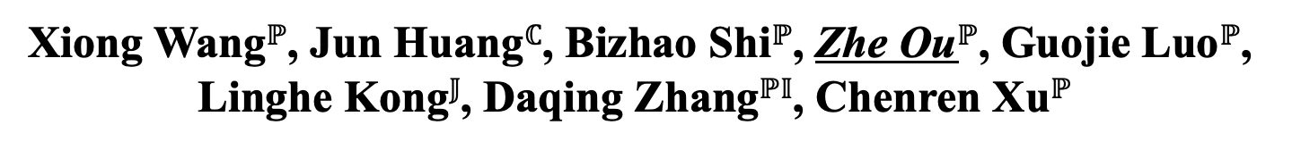
RF-SIFTER: Sifting Signals at Layer-0.5 to Mitigate Wideband Cross-Technology Interference for IoT
Xiong Wang$ℙ$, Jun Huang$ℂ$, Bizhao Shi$ℙ$, Zhe Ou$ℙ$, Guojie Luo$ℙ$, Linghe Kong$𝕁$, Daqing Zhang$ℙ𝕀$, Chenren Xu$ℙ$
$ℙ$Peking University $ℂ$City University of Hong Kong $𝕁$Shanghai Jiao Tong University $𝕀$Institut Polytechnique de Paris

Slide 2








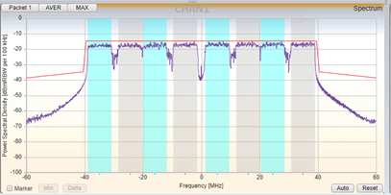


Crisis for IoT Communication
IoT Device
IoT Gateway
Cross-Technology Interference
···
Wideband networks become increasingly aggressive for channel resources
IoT uplinks are essential
Significant cross-technology interference (CTI) for IoT uplinks

Slide 3


Limitation for Prior Works
Solve in Frequency and Time Domain
Power
Power
IoT
Poor Performance
Rely on available channel resources left by CTI signals
CTI
Time
Frequency
WISE: Time Domain
G-Bee: Frequency Domain
Solve with Spatial Domain Cross-technology MIMO
Poor Generality
Rely on decoding CTI and IoT preambles to perform beamforming
Zigbee-only
Gateway
WiFi-only
Interference
Antenna Array

Slide 4
Our Goals
Performance
Generality
Transparency
Survive aggressive wideband CTI
Recover low-power IoT uplink signals
Independent of technology
Support of existing and future IoT
Effective against a wide range of CTI
Integration into IoT gate-way without modifying existing IoT stack
Ensuring practical deployment

Slide 5
Key Idea of RF-Sifter
Key observation: CTI bandwidth are typically much greater than IoT
Key idea: Sifting signals based on bandwidth
Conventional filtering: passes both CTI and IoT signals within passband
Signal sifting: only narrowband IoT signals can go through
Stopband
CTI+IoT
Stopband
IoT
Passband
Passband
Stopband
Stopband
IoT signal
CTI

Slide 6






Our Approach
Leverage bandwidth disparity to enable blind cross-tech beamforming
  Ensuring high performance and generality
Designed as a Layer-0.5 requiring no PHY layer cooperation
  Ensuring transparency
Blind Beam Learning
IoT Source
Wideband CTI
IoT
Wi-Fi
Jammer
Layer 0
Antenna Array
Frontend
1
…
N-1
N
IoT Bandwidth
Layer 0.5
RF-Sifter
CTI Bandwidth
…
Layer 1 PHY

Slide 7
Key Challenges
Beam Estimation in the presence of frequency-selective fading
  - Genetic beam searching for beam refinement
Effective beamforming at Layer-0.5
  - Concentric receive window control
Maintaining transparency to the PHY layer
  - IoT packet reshaping

Slide 8
Experiment Implementation
Hardware Implementation
  - Popular edge computing FPGA chip
  - 4 USRPs with 8 channels
  - Real-time processing
Firmware Implementation
  - Open source Zigbee, BLE and RFID
  - Non-modified PHY and MAC layer

Slide 9
Experiment Methodology
CTI selection
  - Wi-Fi
  - RF jammer
Baseline Selection
  - Raw Scheme
  - Directional Beamforming

Slide 10
SINR Improvement
Pre / Post beamforming SINR comparison (Upper left is better)
- SINR gain: >10dB(100%), >20dB(56%), 38dB(max)
BLE w/ Wi-Fi
BLE w/ Jammer

Slide 11
Packet Receive Rate Performance
PRR experimental CDF (Lower right is better)
- Average PRR boost: 4x Directional, 3.3x Raw
BLE w/ Wi-Fi
Zigbee w/ Wi-Fi

Slide 12
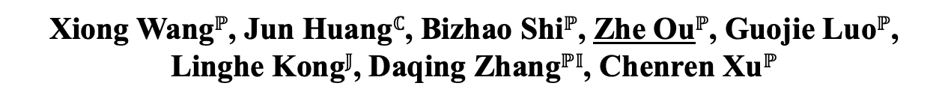
RF-SIFTER: Sifting Signals at Layer-0.5 to Mitigate Wideband Cross-Technology Interference for IoT
Xiong Wang$ℙ$, Jun Huang$ℂ$, Bizhao Shi$ℙ$, Zhe Ou$ℙ$, Guojie Luo$ℙ$, Linghe Kong$𝕁$, Daqing Zhang$ℙ𝕀$, Chenren Xu$ℙ$
Take-away Messages
Leverage bandwidth disparity to enable highly-effective cross-technology beamforming for IoT uplinks.
Operate at Layer-0.5, ensuring generality for a wide range of co-existing scenarios.
Increase SINR by up to 29dB and enhance PRR by 5x for popular IoT technologies under various CTI.

