Slide 1
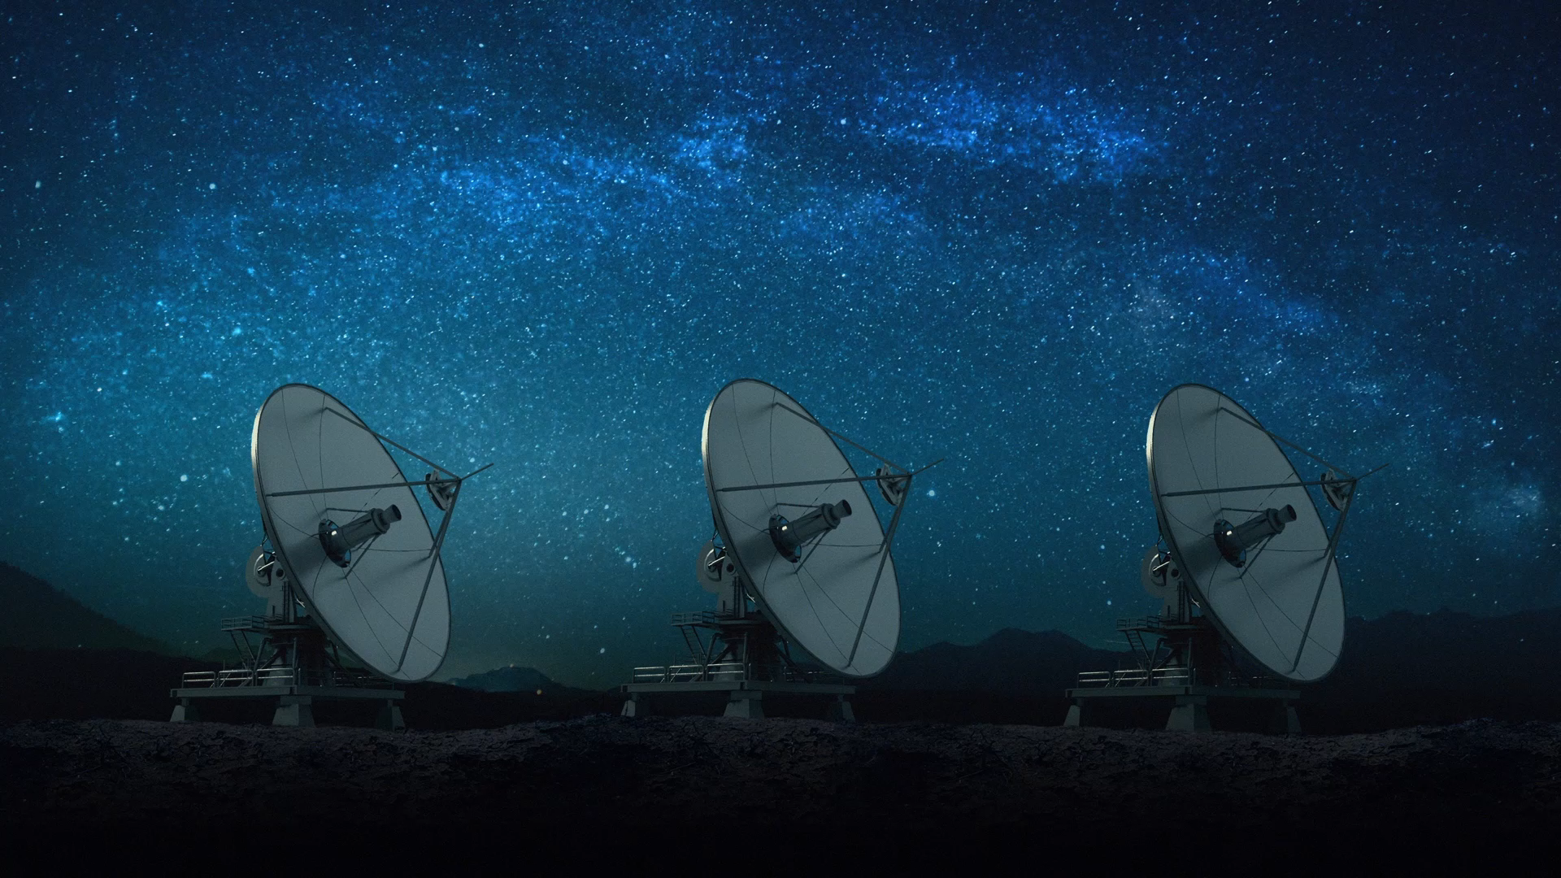

Umbra: Scheduling Satellite Traffic through Space and Time
Bill Tao, Maleeha Masood, Indranil Gupta, Deepak Vasisht
Notes:
I am here to talk about how to efficiently schedule network traffic for low earth orbit satellites. This is a joint work with Maleeha, Indranil and Deepak.

Slide 2
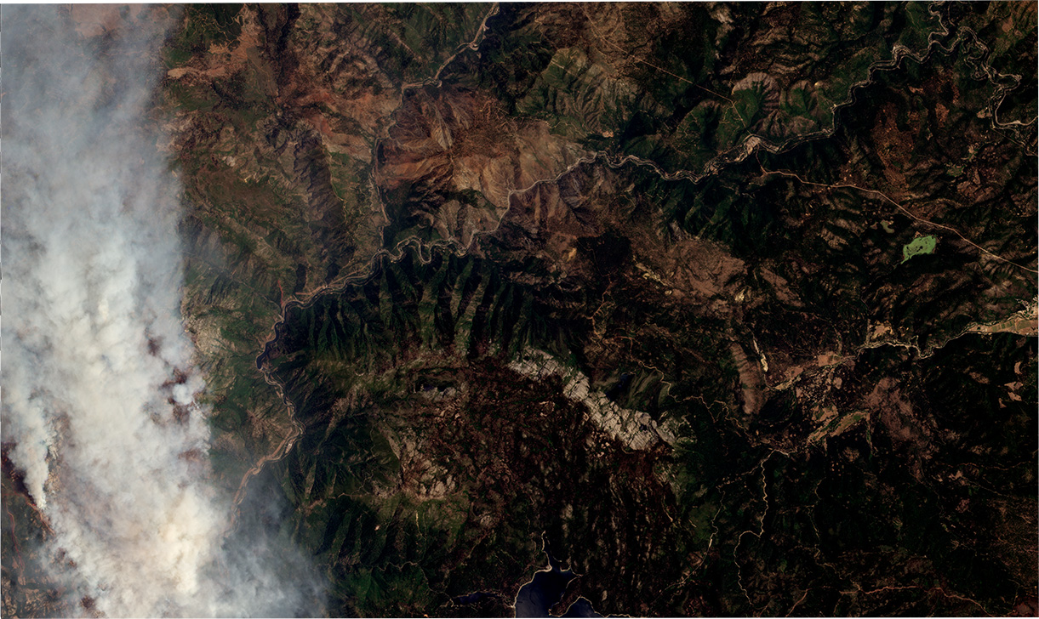
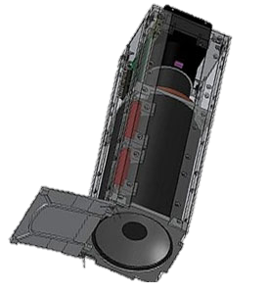
>200 satellites
Low orbit cubesats
Covers the entire Earth 3 times a day
500 Terabytes of images per day
Experience network delays of 24 Hours
Notes:
Imagine that you are the chief of the fire department of California, and you job includes dispatching firefighters to respond to wildfires. Luckily, there are commercial companies out there that launches satellites to take photos like this. These images are taken using small cubesates that are no larger than your arm, orbiting on a low orbit that is just a few hundreds of kilometers above ground. The companies have hundreds of them flying around the earth and covers the entire earth up to 3 times a day. This image would be very useful for applications like wildfire management, however, the current problem is that it experiences network delays of as high as 24h. Having such high delay for fire is very bad, so today we want to take a look at how such latency is possible.

Slide 3





“Bottleneck”
Notes:
The satellites fly in a fixed orbit at constant speed. When an image is captured by a satellite, it is first stored in its cache. Then, when a satellite encounters a ground station, it wirelessly transmits this image to that ground station. The ground station will then transmit this image to a data center through terrestrial network. Previously people believe that the satellite to ground station link is the bottleneck since it is a wireless link of over hundreds of kms.

Slide 4

Idea: Let’s double the bottleneck link
Surprise! 22% Increase in Latency
Notes:
People have been trying to improve the quality of this wireless link. To verify the effect, we did a simulation where we doubled the link capacity. To our surprise, the latency increased by 22%. Why is it so?

Slide 5
In This Talk
Observation: Uneven Queueing effect (UQE)
Umbra: Scheduling over time and space
Evaluation: Reduces P90 latency by 3.5X
Notes:
In today’s talk, I am going to talk about the reason that caused this increased latency: uneven queueing effect. I’m also going to talk about how our system, Umbra, solves the problem by optimizing the transmission schedule.

Slide 6
1-2Gbps
Rural, polar
0.1-1Gbps
Queue!
Notes:
If we take a close look at the system, we can see that the satellite-ground station link has improved greatly now and it has a capacity of up to 1-2Gbps. On contrast, the ground stations are usually positioned in rural areas near the north and south poles to avoid interference and provide better coverage for satellites. Thus, the terrestrial links are of bad quality and have a capacity between 0.1-1Gbps

Slide 7
Queue
Queue!
Notes:
What this means is that during the transmission, the satellite can downlink the images much faster than the ground station can upload, causing a queue build-up at the ground station

Slide 8
With Multiple Ground Stations…
Queue!
Notes:
Let’s look at a more realistic scenario, where the company generally has multiple ground station distributed at different locations.

Slide 9
Queue!
Notes:
A satellite would fly in its orbit, collecting images, and downlink them when it encounters a ground station

Slide 10
Queue!
Notes:
It would continue to take images on its way and downlink them to another ground station when they are in contact

Slide 11
With Multiple Ground Stations…
Uneven Queuing
Queue!
Notes:
Since the non-even distribution of the ground stations, the queues are generally not of equal length. This is exaggerated when the satellites have higher downlink bandwidth and can dump even more images to a single ground stations.

Slide 12
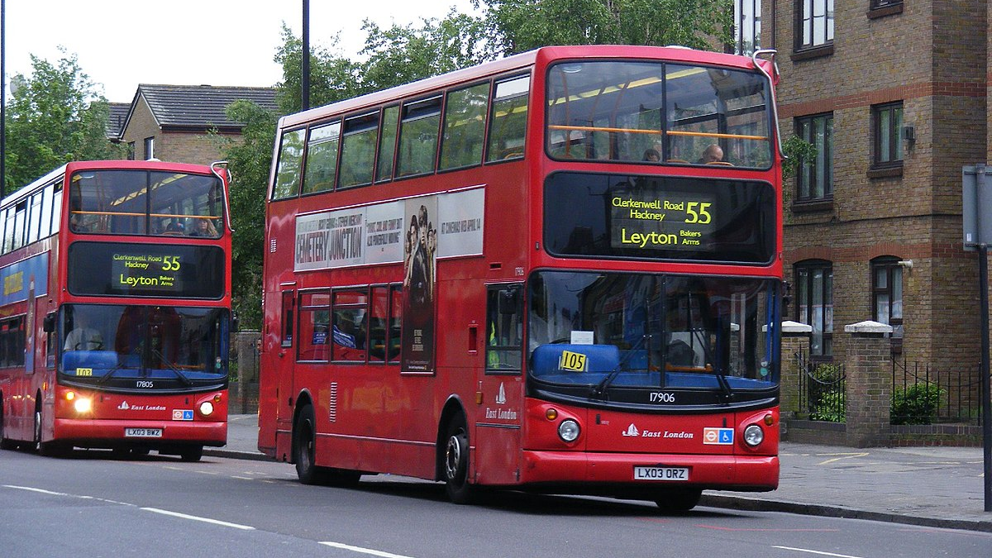
Notes:
We name this phenomenon as the uneven queueing effect (UQE), which actually happens in real life when you wait for buses: when two buses come at once, you will find the first bus to be always more crowded!

Slide 13
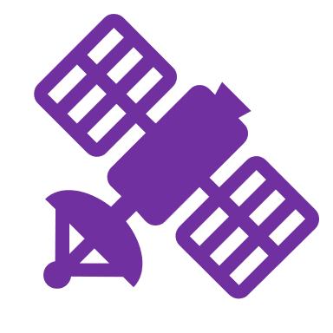
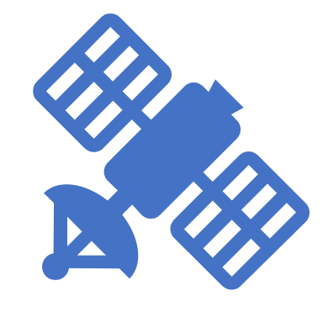

With Multiple Satellites…
They share the orbit!
Notes:
Now let’s consider the real case where there are multiple satellites. When there are multiple riders waiting for the bus, will they balance out the buses here? Generally these satellites are flying in a limited set of orbits to minimize the risk of collision.

Slide 14
With Multiple Satellites…
Queue!
Notes:
Since the satellites are sharing orbits, they generally experience similar data load distributions, and therefore this uneven queueing effect is exaggerated, rather than averaged out within multiple satellites.

Slide 15

Queue!
Notes:
Replace figure by Maleeha’s figure.

Slide 16



Slide 17
With Multiple Satellites…
Uneven Queuing Exaggerates
Notes:
Replace figure by Maleeha’s figure.

Slide 18
In This Talk
Observation: Uneven Queueing effect
Umbra: Scheduling over time and space
Evaluation: Reduces P90 latency by 3.5X
Notes:
We build a new system, Umbra, which solves this problem by intelligently scheduling the image transmission over space and time.

Slide 19
Idea: Withhold Scheduling
Idea: Don’t send all the data down
Notes:
Umbra follows such idea: Withhold Scheduling. Since downlinking all the images is a bad idea, we should of course withhold some image to downlink to a less crowded ground station later.

Slide 20
With Multiple Ground Stations…
Queue!
Notes:
Back to our original example, for the satellite, if it withholds one image from the first ground station and downlinks it to the second, the queues are even now.

Slide 21
Queue!
Notes:
Replace figure by Maleeha’s figure.

Slide 22
Queue!
Notes:
Replace figure by Maleeha’s figure.

Slide 23
With Multiple Ground Stations…
Even Queuing
Queue!
Challenge: 200 Satellites, 12 Ground Stations, 48 Antennas
Notes:
However, the challenge here is that real-world systems contain hundreds of satellites, and tens of ground stations with multiple antennas. It is non-trivial to obtain an optimal transmission schedule for such complicated system

Slide 24


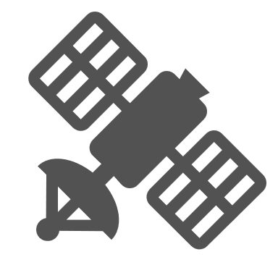



Umbra: Space-Time Coupling
Notes:
We solve this problem by realizing that in the traditional way of scheduling, the system at each time instance is treated independently based on the connectivity graph of that time. However, the system is not time-independent. The transmission now will affect the queue sizes in the future. To model this, we add “temporal edges” in the graph, which means that if an image is stored in cache on either the satellite or the ground station, it’s equivalently being sent to the future. “Then, maximizing **transmission efficiency** here is equivalent to maximizing the data flow over this network, this is known as the maximum flow problem in graph theory”

Slide 25
Umbra: Space-Time Coupling
T
T+1
T+2
Past work treats each time step as independent
Withhold =
Send to the “future”
Goal: Maximize Data Flow
Notes:
We solve this problem by realizing that in the traditional way of scheduling, the system at each time instance is treated independently based on the connectivity graph of that time. However, the system is not time-independent. The transmission now will affect the queue sizes in the future. To model this, we add “temporal edges” in the graph, which means that if an image is stored in cache on either the satellite or the ground station, it’s equivalently being sent to the future. “Then, maximizing **transmission efficiency** here is equivalent to maximizing the data flow over this network, this is known as the maximum flow problem in graph theory”

Slide 26



Umbra: Transmission Schedule as Flow Graph
S
“Source”= Image Capturing
“Target” = Image Uploading
C
Notes:
“To formulate this as a maximum flow problem, we add a source and a target node to form a complete graph"

Slide 27
In This Talk
Observation: Uneven Queueing effect
Umbra: Scheduling over time and space
Evaluation: Reduces P90 latency by 3.5X
Notes:
We evaluated Umbra in a best-effort realistic setting.

Slide 28

Evaluation
Evaluation Setup
Real-world trace: Planet Dove
  4 days of data
  Metadata of over 10 million images
  Total data transmission of ~1.9PB
Code & dataset available: github.com/ConnectedSystemsLab/Umbra
Notes:
Our evaluation uses a trace collected from a real LEO satellite constellation: the planet dove. The trace consists of 4 days of operational data from Planet Dove. It includes over 10 million images with total size of over 1.9PB. We did a trace-driven simulation and our code and dataset is available online.

Slide 29
Evaluation: Latency
Greedy
Umbra
Umbra achieves 3.5X Decrease in P90 Latency
Notes:
We first looked at the latencies. We plot the latency distribution of Umbra vs. the traditional downlinking schedule here, and as you can see Umbra achieves 3.5X improvement in P90 latency

Slide 30
Did we solve UQE?
Umbra Reduces Uneven Queuing
Notes:
We also verified if we solved the problem of uneven queueing effect. We look at 2 example ground stations here. For one of them, we can see that with traditional method, there are little data load and great amount of idle time when it’s wasting its uploading bandwidth. With umbra, such idle time is eliminated. For the other one, with traditional method, we can see that it suffers from an ever increasing queue because of too much data load. After umbra is deployed, the data queue no longer builds up. This demonstrates Umbra’s ability to balance the load between ground stations.

Slide 31
Conclusion
Uneven queuing leads to large delays in satellite-ground links
Withhold scheduling balances workloads to reduce latency
Next Step: Edge computing on satellites to achieve minute-level latency (coming up at NSDI’ 24!)
Notes:
In conclusion, we observed that uneven queueing effect leads to large network delays in LEO satellite systems. We developed a Umbra to solve this by scheduling optimal transmission. Our end goal is to have a near-real-time earth monitoring system. And for this, I invite you to come check out our subsequent work on performing edge computing on satellites which will appear in NSDI 2024.

