Slide 1



Scattering from Rough Surfaces in 100+ GHz Wireless Mobile Networks: From Theory to Experiments
Ruiyi Shen and Yasaman Ghasempour
Department of Electrical and Computer Engineering, Princeton University
ACM MobiCom 2023, Madrid, Spain

Slide 2
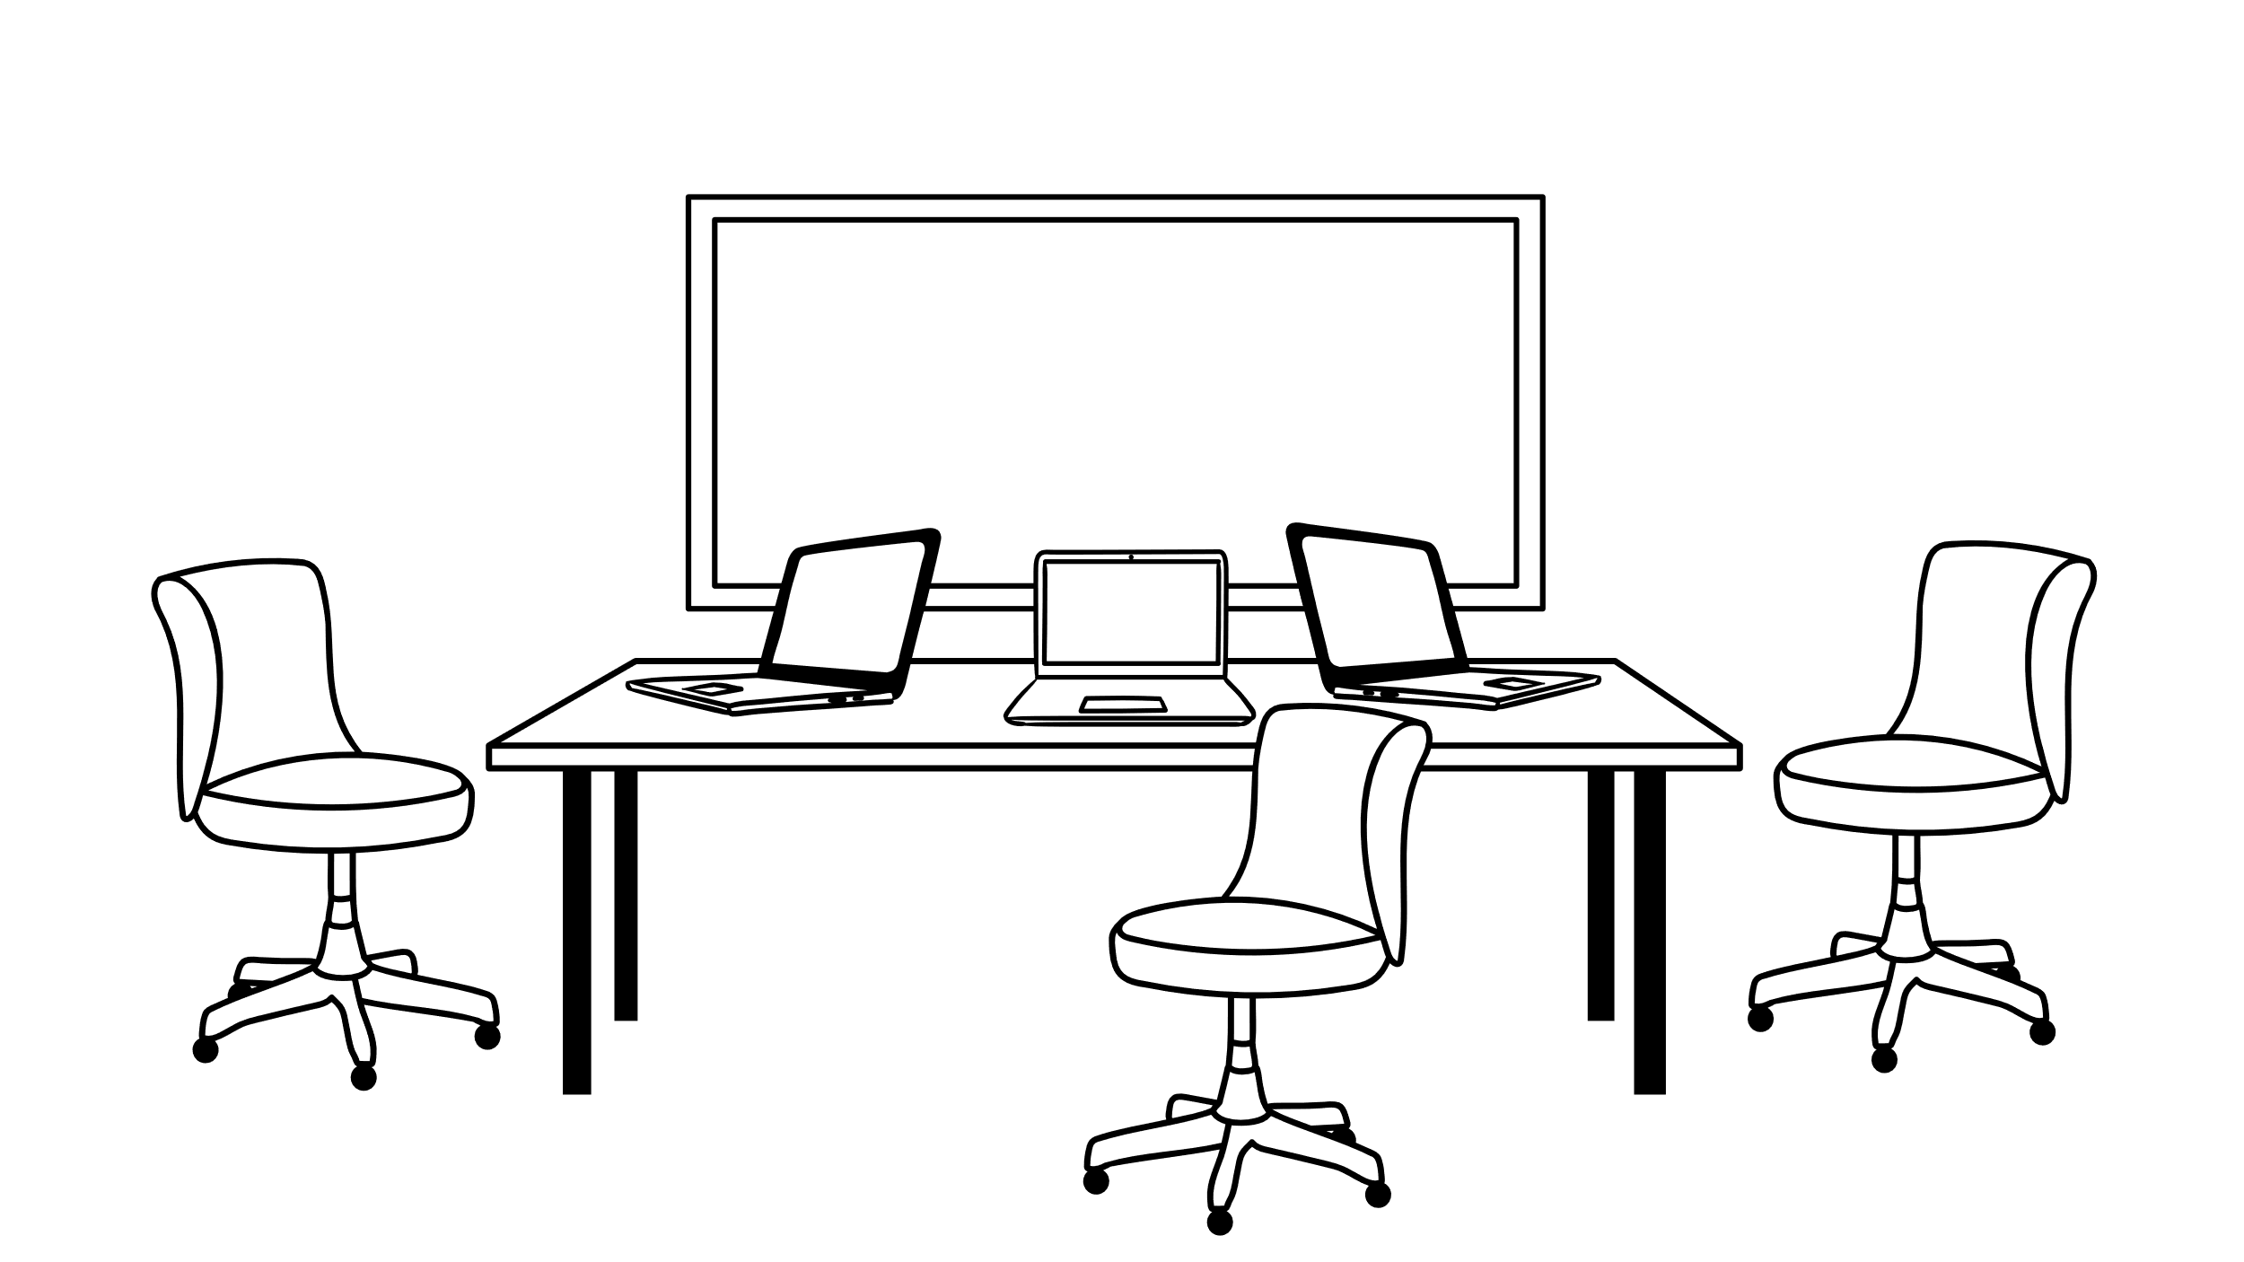





Wireless Links at 100+ GHz Frequencies
ACM MobiCom 2023, Madrid, Spain

Slide 3

Wireless Links at 100+ GHz Frequencies
Increasingly directional beams at 100+ GHz frequencies
ACM MobiCom 2023, Madrid, Spain

Slide 4

Wireless Links at 100+ GHz Frequencies
Increasingly directional beams at 100+ GHz frequencies
Lower chance for establishing LOS link
ACM MobiCom 2023, Madrid, Spain

Slide 5
Wireless Links at 100+ GHz Frequencies
Increasingly directional beams at 100+ GHz frequencies
Lower chance for establishing LOS link
NLOS links become crucial
Surface reflection behavior has been oversimplified
ACM MobiCom 2023, Madrid, Spain

Slide 6
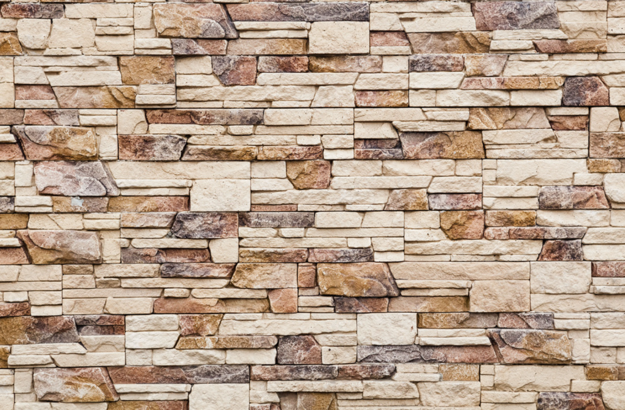
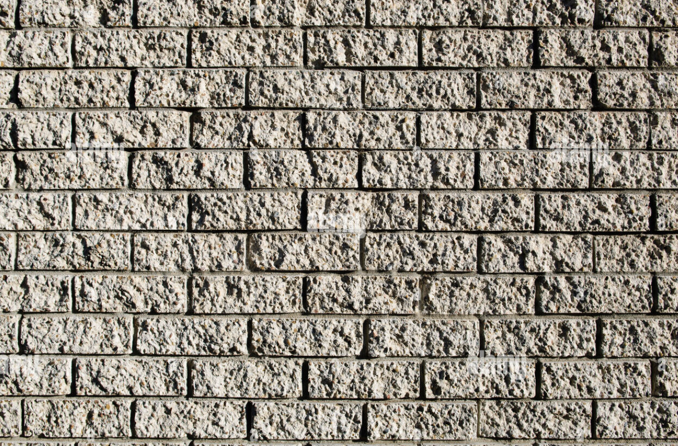



Reflection at High Frequencies
At lower frequencies, most surfaces are considered smooth
They can be electromagnetically rough at sub-THz frequencies
Why is understanding rough scattering important?
Indoor
Outdoor
ACM MobiCom 2023, Madrid, Spain
3

Slide 7


Impact on Peak Specular Power and Angular Coverage
Smooth surfaces: large specular SNR, but drops rapidly at non-specular angles
Rough surfaces: lower specular SNR, but comparable SNR at non-specular angles
Smooth Surface
Rough Surface
Power
Power
Angle
Angle
Low HPSW
High HPSW
Half-Power Scattering Width (HPSW)
ACM MobiCom 2023, Madrid, Spain
4

Slide 8





Impact on DL/UL Channel Reciprocity
Incident angle dependency of scattering results in non-reciprocal DL/UL channels
Adds overhead to beam search procedure
$$θ_{i}′$$
$$θ_{i}≠θ_{s}$$
$$θ_{i}$$
$$θ_{s}$$
$$θ_{s}$$
Downlink
Uplink
ACM MobiCom 2023, Madrid, Spain
5

Slide 9
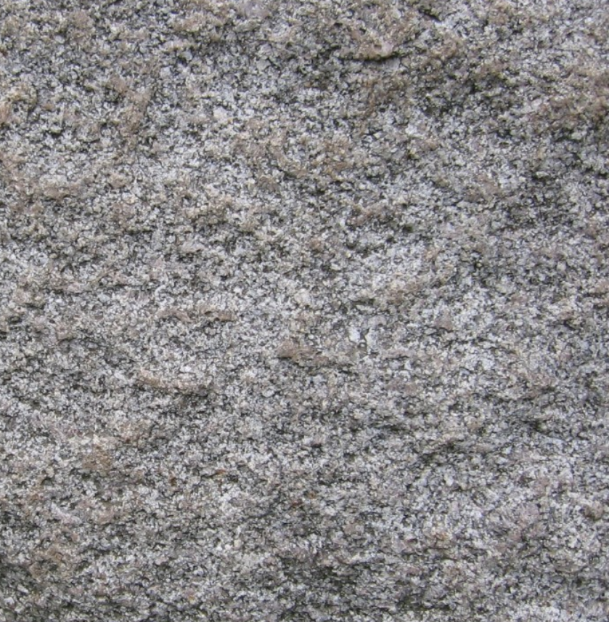
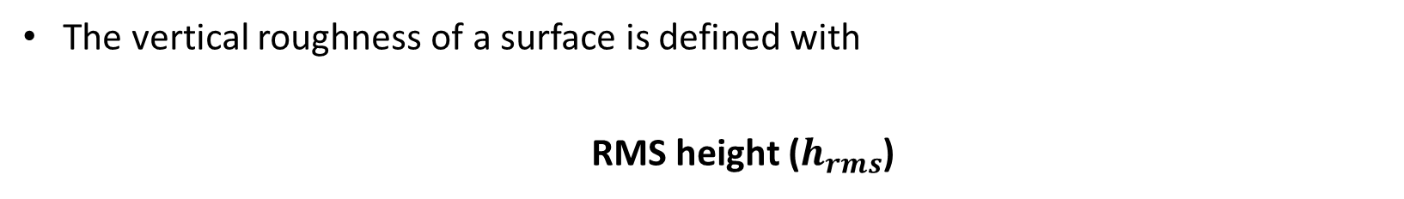

Defining Surface Roughness
The vertical roughness of a surface is defined with
  RMS height ($h_{rms}$)
$$h_{rms}$$
ACM MobiCom 2023, Madrid, Spain
6

Slide 10




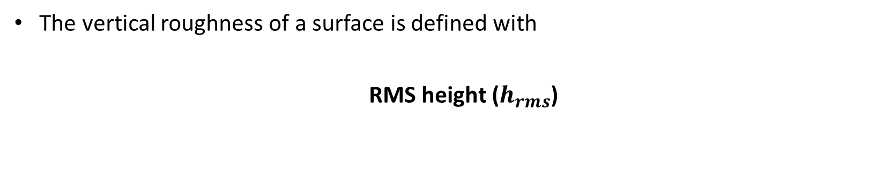



Defining Surface Roughness
The vertical roughness of a surface is defined with
  RMS height ($h_{rms}$)
Surface roughness can be classified with Rayleigh’s Criterion
$$φ_{1}$$
$$φ_{2}$$
$$θ_{i}$$
$$h_{rms}< \frac{λ}{8cosθ_{i}}$$
$$θ_{i}$$
140 GHz: 300 – 500 $μm$
${|φ}_{1}−$ $φ_{2}|<\frac{ π}{2}$
ACM MobiCom 2023, Madrid, Spain
6

Slide 11

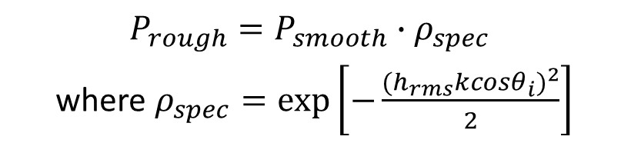






Scattering Power at the Specular Angle
$$P_{inc}$$
$$P_{smooth}$$
$$P_{inc}$$
$$P_{rough}$$
$$θ_{i}$$
$$θ_{i}$$
$P_{rough}=P_{smooth}∙ρ_{spec}$
where $ρ_{spec}=exp⁡\left[−\frac{{(h_{rms}kcosθ_{i})}^{2}}{2}\right]$
$$P_{smooth}=P_{inc}{∙Γ}_{smooth}$$
$P_{rough}$has an inverse exponential relationship with $h_{rms}$ and frequency
ACM MobiCom 2023, Madrid, Spain
7

Slide 12

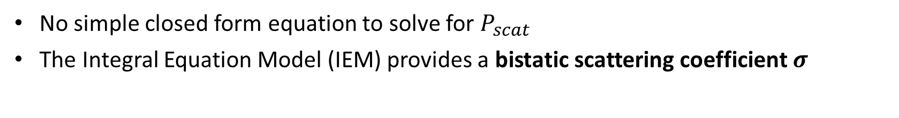



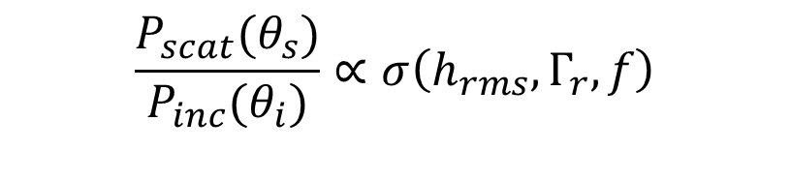
Scattering Power at Non-specular Angles
$$P_{inc}$$
$$θ_{i}$$
$$P_{scat}$$
$$θ_{s}$$
No simple closed form equation to solve for $P_{scat}$
The Integral Equation Model (IEM) provides a bistatic scattering coefficient $σ$
$$\frac{P_{scat}(θ_{s})}{P_{inc}(θ_{i})}∝σ\left(h_{rms}, Γ_{r}, f\right)$$
ACM MobiCom 2023, Madrid, Spain
8

Slide 13
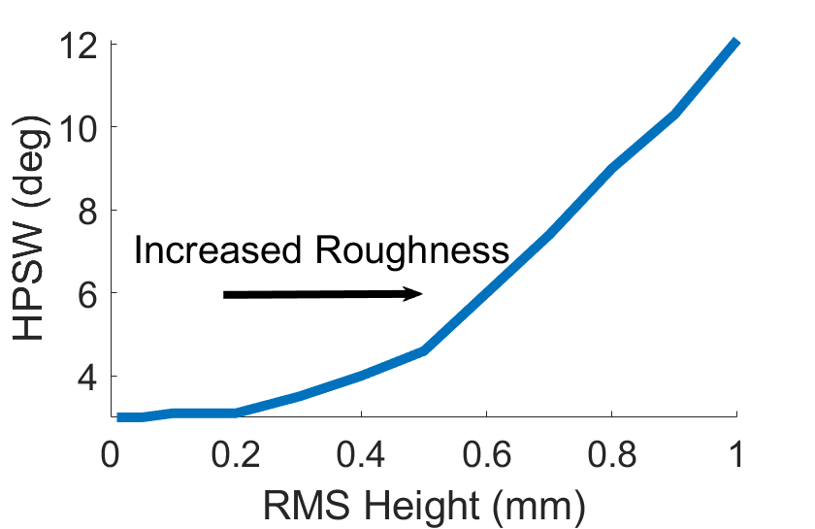





Scattering Power at Non-specular Angles
$$P_{inc}$$
$$HPSW$$
$$θ_{i}$$
$$P_{scat}$$
$$θ_{s}$$
No simple closed form equation to solve for $P_{scat}$
The Integral Equation Model (IEM) provides a bistatic scattering coefficient $σ$
$$\frac{P_{scat}(θ_{s})}{P_{inc}(θ_{i})}∝σ\left(h_{rms}, Γ_{r}, f\right)$$
ACM MobiCom 2023, Madrid, Spain
8

Slide 14
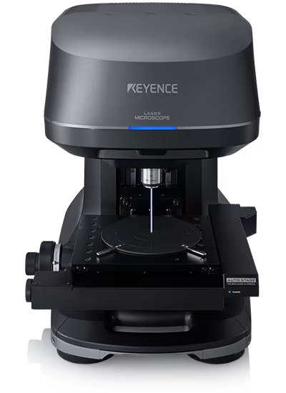
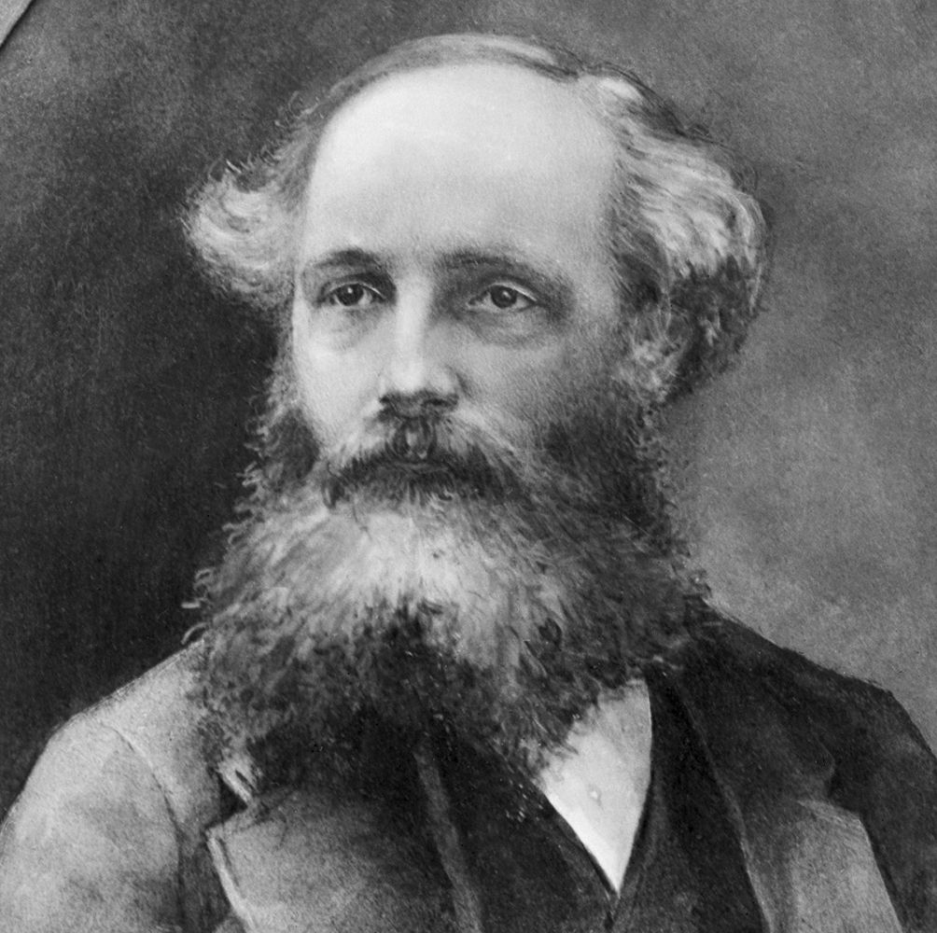
Can we measure surface roughness?
Putting surface samples under the microscope
More scalable solutions?
Can we calculate rough scattering pattern?
Solving Maxwell’s Equations
ACM MobiCom 2023, Madrid, Spain
9

Slide 15
Categorizing the roughness level of surfaces is sufficient!
Smooth
Semi-Rough
Rough
ACM MobiCom 2023, Madrid, Spain
10

Slide 16




Objective: Categorize Roughness Level at Minimal Overhead
Frequency Spectrum?
$$R(f)$$
$$r(t)$$
$$f$$
Single reflection provides insufficient information on rough scattering
ACM MobiCom 2023, Madrid, Spain
11

Slide 17







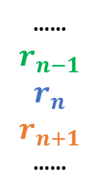




Inferring Roughness via Angular Diversity
$$R(f)$$
……
$$r_{n−1}$$
$$r_{n}$$
$$r_{n+1}$$
……
FFT
$$f$$
Beam n+2
Inter-Beam Spectral Correlation
…
$$r_{n−1}$$
$$r_{n+1}$$
$$r_{n}$$
$$\hat{X}$$
Beam n-2
…
Rough
Semi-Rough
Beam n: $θ_{i}=θ_{s}$
Smooth
$$… n−1$$
$$n$$
$$n+1 …$$
ACM MobiCom 2023, Madrid, Spain
11

Slide 18
Inferring Roughness via Angular Diversity
Adds minimal overhead on top of conventional beam search protocol
…
Does not require specific motion pattern from TX/RX
…
ACM MobiCom 2023, Madrid, Spain
11

Slide 19
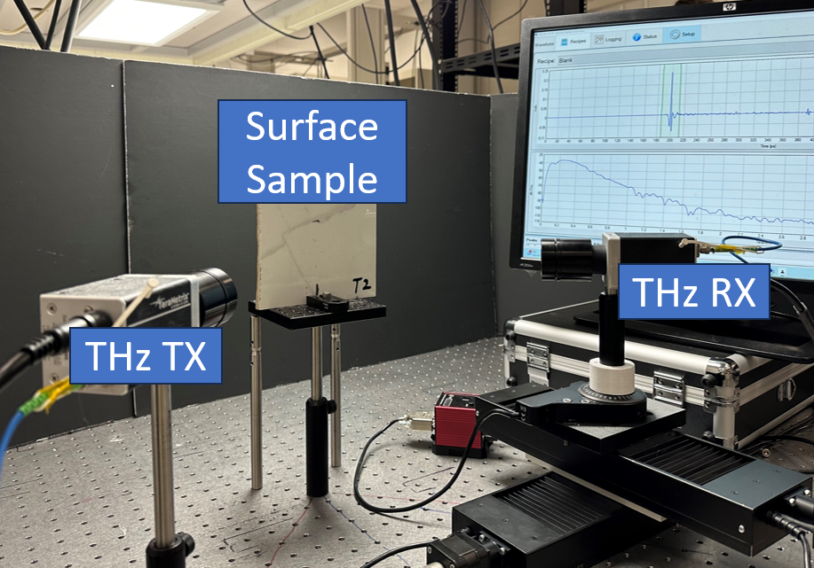
Experimental Setup
ACM MobiCom 2023, Madrid, Spain
12

Slide 20
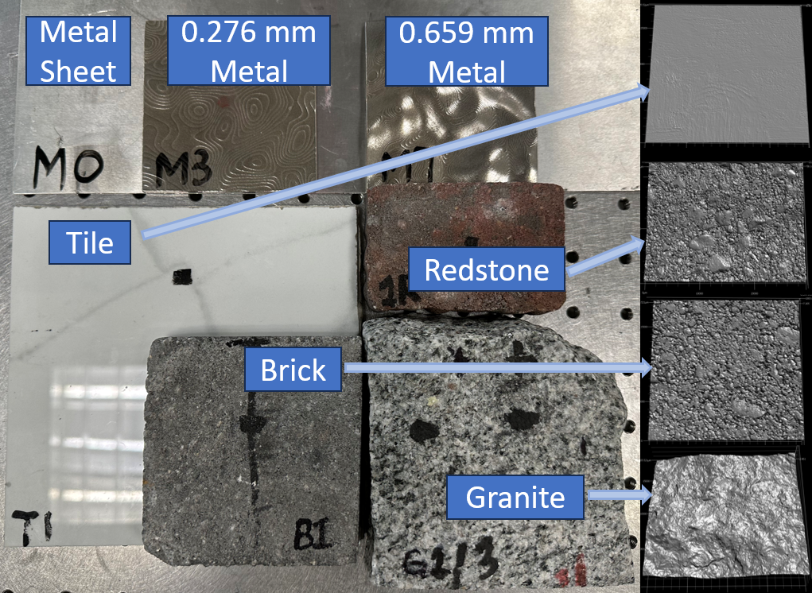
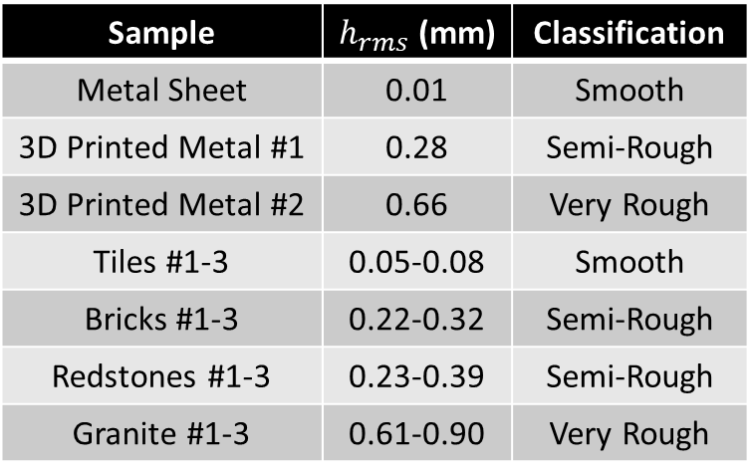
Surface Samples Tested
Sample | $h_{rms}$ (mm) | Classification
Metal Sheet | 0.01 | Smooth
3D Printed Metal #1 | 0.28 | Semi-Rough
3D Printed Metal #2 | 0.66 | Very Rough
Tiles #1-3 | 0.05-0.08 | Smooth
Bricks #1-3 | 0.22-0.32 | Semi-Rough
Redstones #1-3 | 0.23-0.39 | Semi-Rough
Granite #1-3 | 0.61-0.90 | Very Rough
ACM MobiCom 2023, Madrid, Spain
13

Slide 21




Evaluating Peak Specular SNR
15
Non-metal samples
Metal sample
)
10
Model
B
d
(
5
R
N
S
0
$$θ_{i}$$
$$θ_{s}$$
d
e
z
-5
i
l
a
m
r
-10
o
N
$$θ_{i}=θ_{s}=45°$$
-15
-20
0
0.2
0.4
0.6
0.8
1
RMS Height (mm)
SNR at specular angle exponentially decreases as a function of RMS height
ACM MobiCom 2023, Madrid, Spain
14

Slide 22

Evaluating Scattering Width
TX
RX
$$45°$$
ACM MobiCom 2023, Madrid, Spain
15

Slide 23
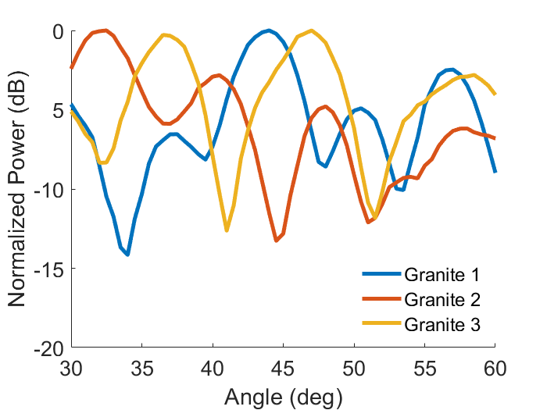
Evaluating Scattering Width
Tile (h
rms
= 0.083 mm)
Redstone (h
rms
= 0.377 mm)
Brick (h
rms
= 0.246 mm)
Granite (h
rms
= 0.748 mm)
Semi-Rough
Rough
0
)
Smooth
B
-5
> 15°
d
(
R
N
-10
S
d
e
Increasing
roughness
z
Increasing roughness
i
l
-15
a
m
r
o
N
-20
-5
0
5
Angular Deviation (deg)
deg
Scattering from rough surfaces has weaker specular power, but wider scattering profile
ACM MobiCom 2023, Madrid, Spain
15

Slide 24


Evaluating Non-Reciprocal DL/UL Channels
5
)
Tile
Redstone
B
Brick
Granite
TX
d
4
(
RX
e
c
n
3
e
Increasing deviation from specular angle
r
e
Increasing roughness
f
f
i
D
2
$$θ_{s}$$
r
$$θ_{i}=45°$$
e
w
o
1
P
0
35
40
45
50
55
Scattering Angle (
s
)
Rough surface scattering creates evident power difference between DL and UL channels
ACM MobiCom 2023, Madrid, Spain
16

Slide 25
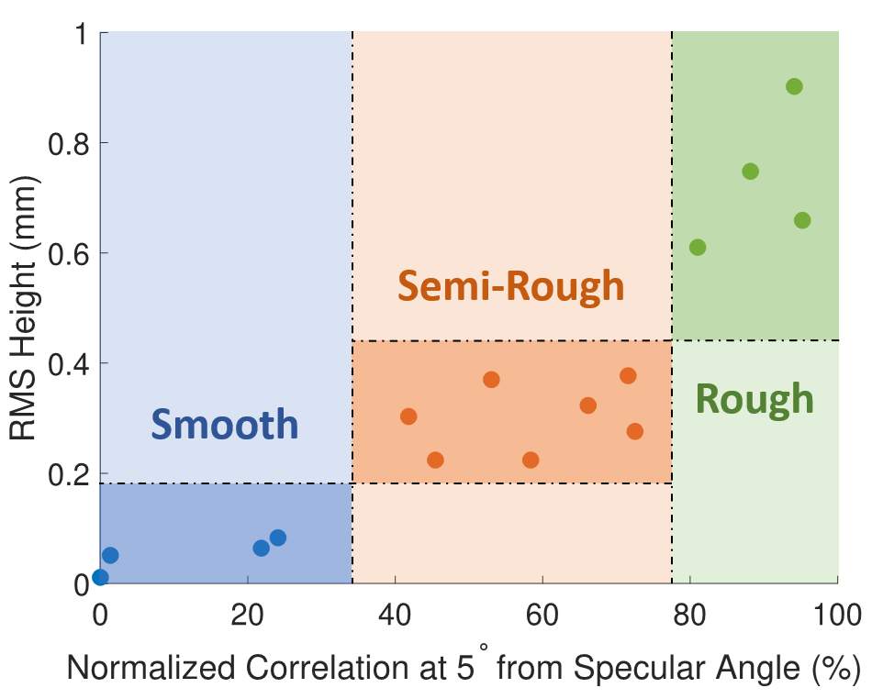
Spectral-Spatial Correlation for Different Surfaces
deg
Correlation between specular and non-specular spectra identifies surface roughness
ACM MobiCom 2023, Madrid, Spain
17

Slide 26
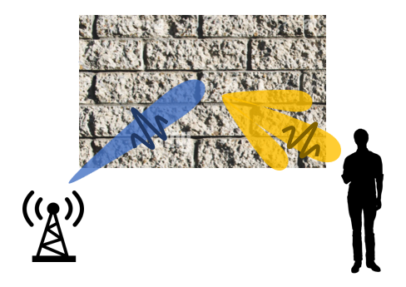
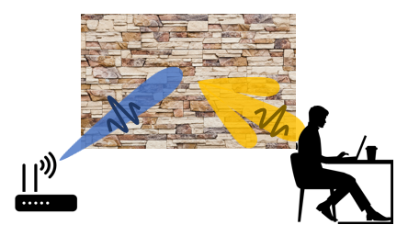
Conclusion and Future Work
A comprehensive theoretical and experimental analysis on the impact of rough scattering on sub-THz wireless networks
A low-overhead roughness characterization method to categorize surfaces
For ongoing work, we go beyond classification to numerically estimate surface parameters
ACM MobiCom 2023, Madrid, Spain
18

Slide 27


Thank you!
ACM MobiCom 2023, Madrid, Spain

