Slide 1

AccessWear: Making Smartphone Applications Accessible to Blind Users
MobiCom 2023, Madrid Spain
2nd October 2023
Prerna Khanna, Shirin Feiz, Jian Xu, IV Ramakrishnan, Shubham Jain, Xiaojun Bi, Aruna Balasubramanian

Slide 2
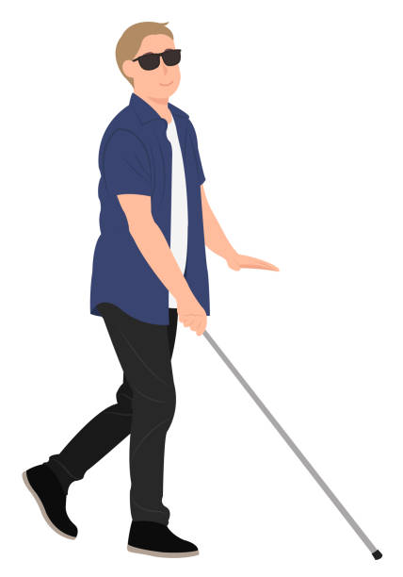
Introduction
Globally there are
43 million
blind users.
Are smartphone interactions accessible?

Slide 3
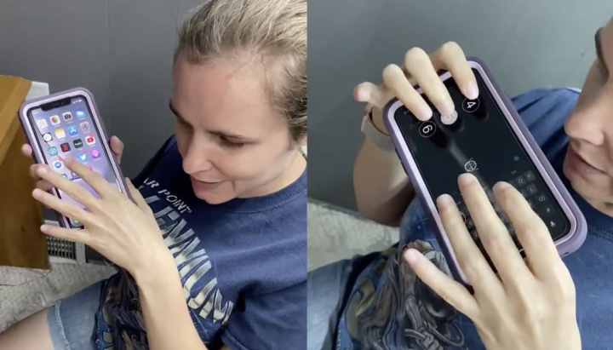
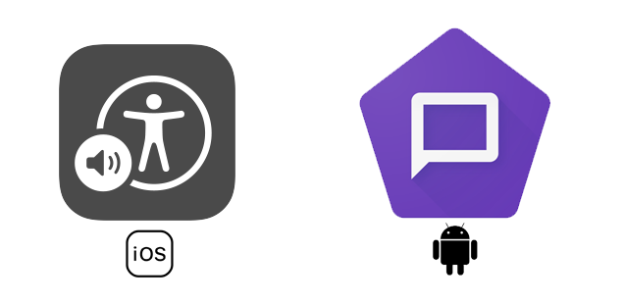
Are Smartphone Interactions Accessible?
One-handed interactions are challenging¹.
Susceptible to shoulder-surfing attacks².
Gestures are overloaded³.
In this work, we focus on using alternate interactions techniques for blind users.
¹ Ali Abdolrahmani, Ravi Kuber, and Amy Hurst. “An empirical investigation of the situationally induced impairments experienced by blind mobile device users”. In: Proceedings of the 13th International Web for All Conference. 2016, pp. 1–8.
² Jian Xu, Syed Masum Billah, Roy Shilkrot, and Aruna Balasubramanian. “DarkReader: bridging the gap between perception and reality of power consumption in smartphones for blind users”. In: The 21st International ACM SIGACCESS Conference on Computers and Accessibility. 2019, pp. 96–104.
³ Barbara Leporini, Maria Claudia Buzzi, and Marina Buzzi. “Interacting with mobile devices via VoiceOver: usability and accessibility issues”. In: Proceedings of the 24th Australian Computer-Human Interaction Conference. 2012, pp. 339–348.

Slide 4
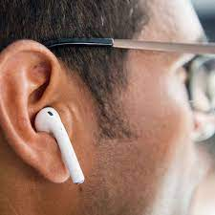
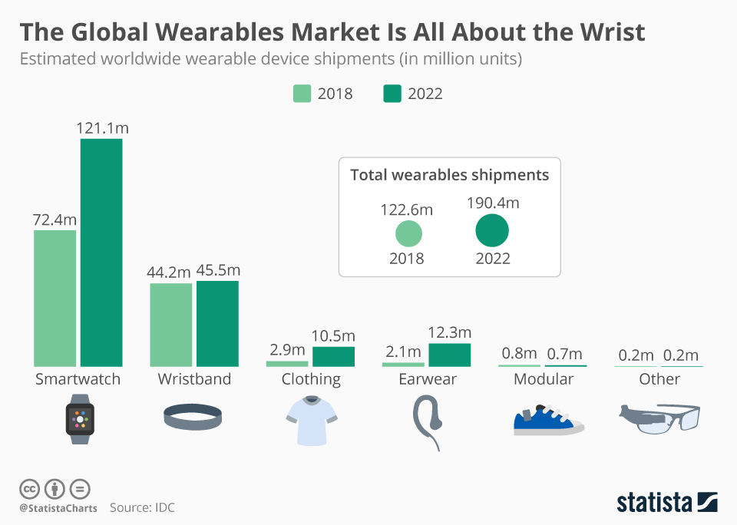
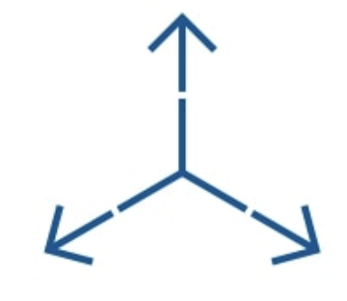
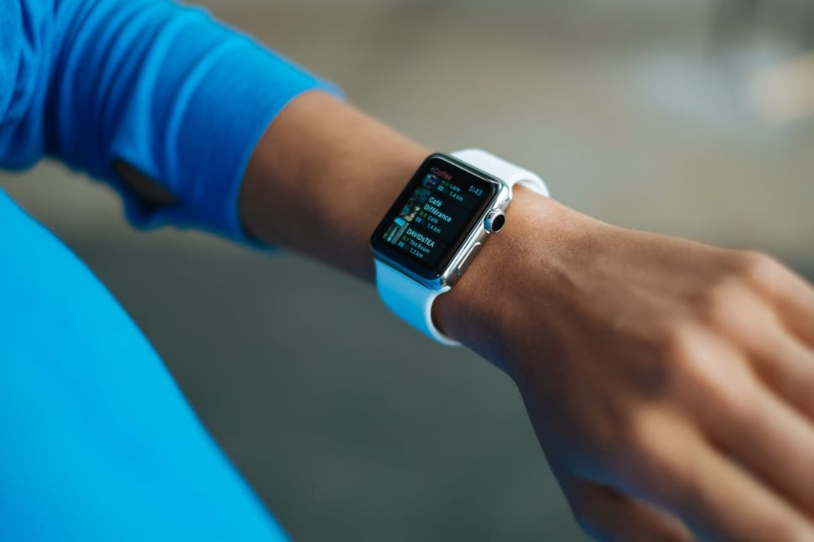


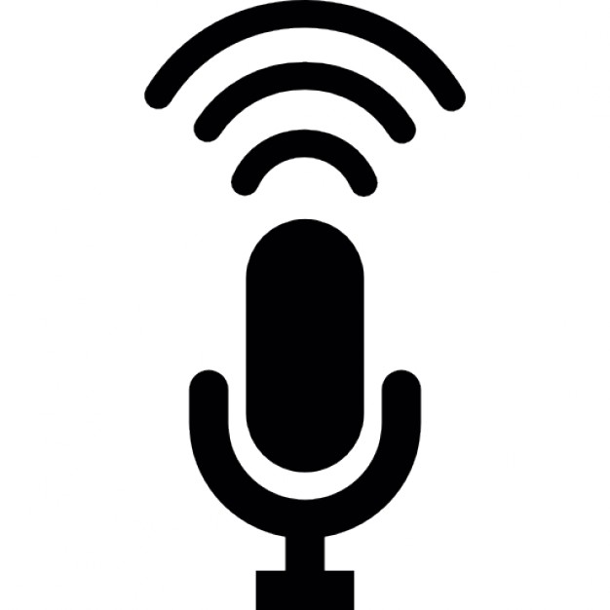


Wearable Devices Can Serve as Alternate Modes of Interaction

Slide 5
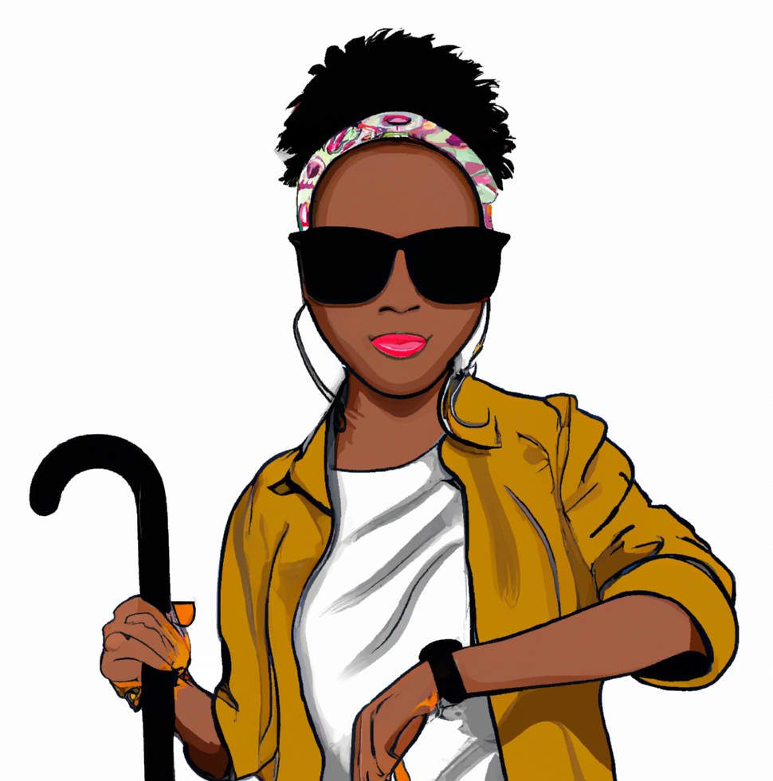
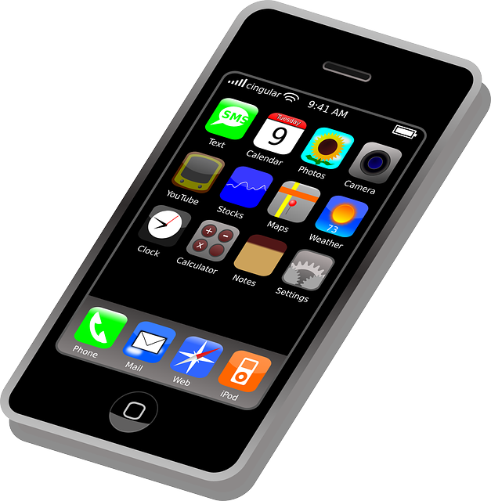
AccessWear: Making Smartphone Applications Accessible to Blind Users

Slide 6
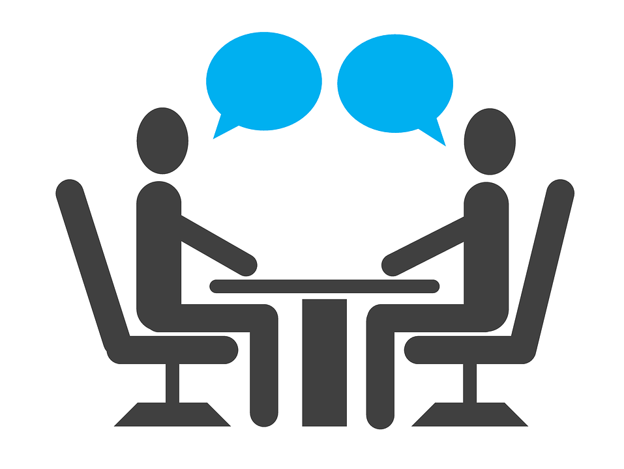
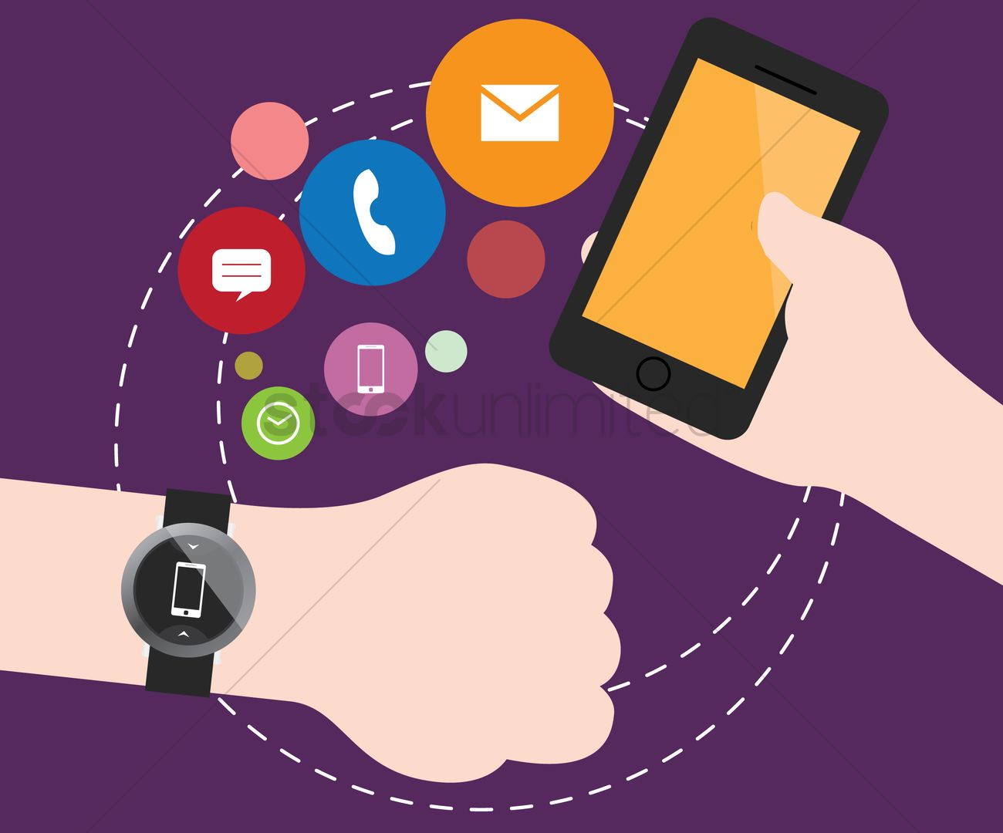
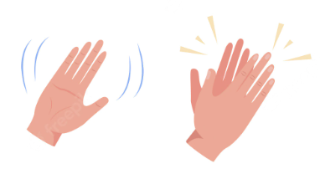
Exploratory Study
IRB-approved study with 9 blind users and 16 sighted users
Survey: Is there a need for alternate interaction?
Semi-structed interviews: What gestures do blind users prefer?
Comparative experiment: Compare gestures of blind & sighted users.

Slide 7
Need for Alternate Gestures
“In public, I don’t feel comfortable with the phone, I don’t want to draw much attention, swipes and all gestures are less noticeable.”
“Gives me the confidence to not take out the phone, everyone carries a watch, if I wave no one will know I am using a phone.”
“More security, keep phone inside the pocket.”
“Convenient, easy access.”
Implication 1: Participants prefer an alternate input modality.

Slide 8
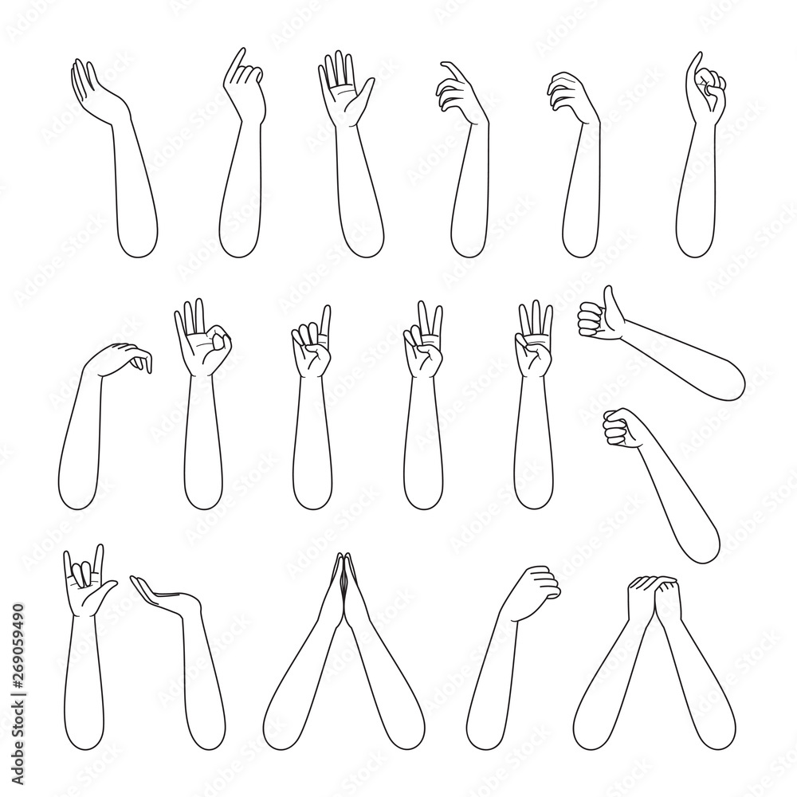
Varied Gesture Preferences
Forearm gestures
Shape gestures
Finger gestures
Wrist rotation gestures
Median
score: 7 5 7 3
1: strongly do not prefer
7: strongly prefer
Implication 2: Gesture should be easily customizable.

Slide 9
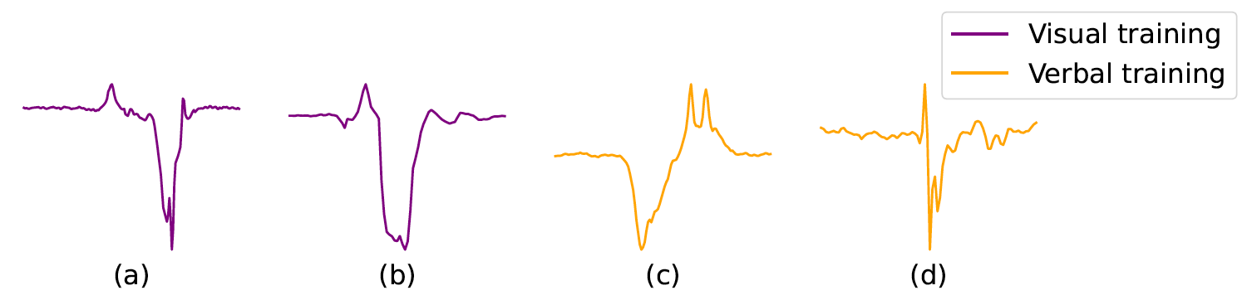
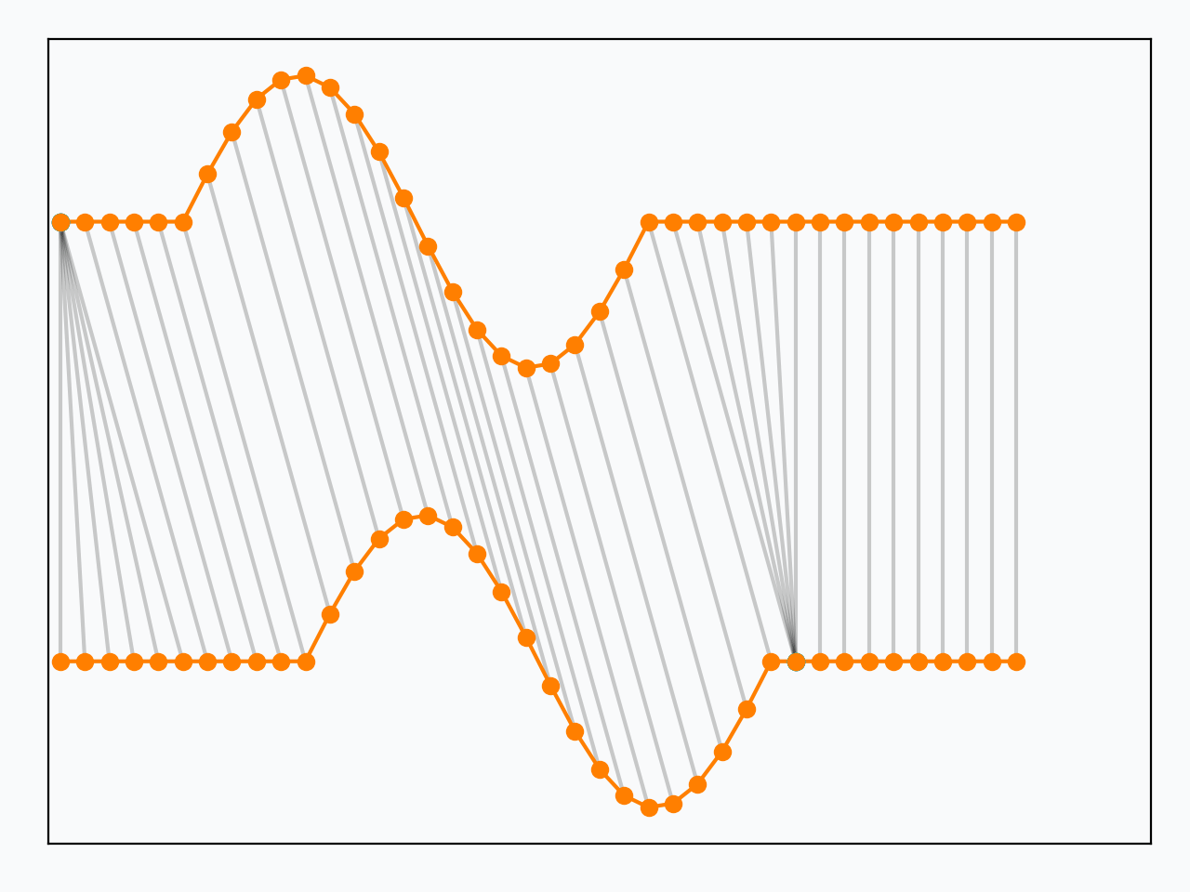
High Inter-user Variance
Template
Sighted Users
User’s gesture
Inter-user variance
Blind users: 65.2
Sighted users: 29.8
Implication 3: Existing gesture recognition techniques using training data from sighted users are unlikely to work for blind users.
Blind Users

Slide 10
AccessWear Contributions
A robust gesture recognition system that works well with commodity sensors for blind users.
Near-zero-effort gesture replacement that allows a user to flexibly use any smartwatch gesture to interact with unmodified applications.

Slide 11
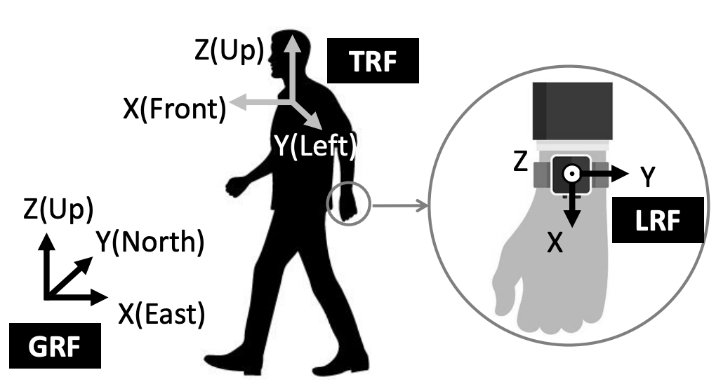
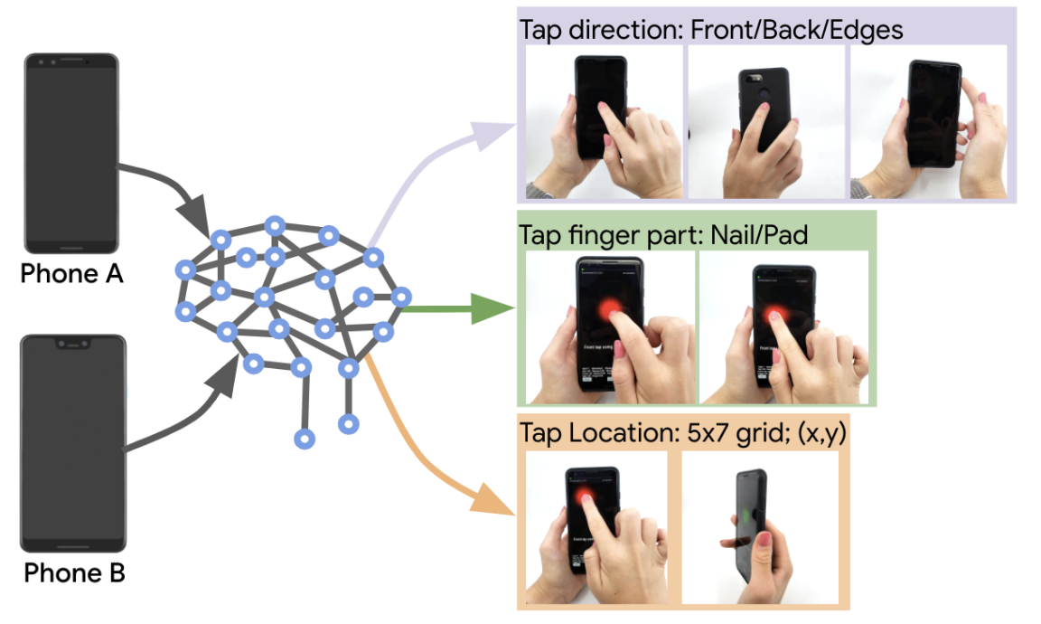
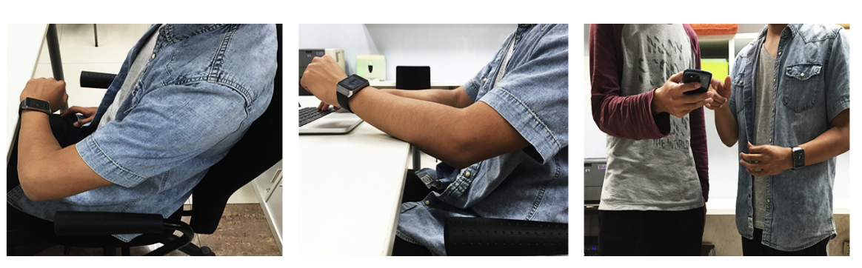
Gesture Recognition Challenges
MUSE (MobiCom’ 18)¹
Tap-Net (CHI’ 21)²
Serendipity (CHI’ 16)³
Does not run on mobile
Requires lot of
training data
Requires Per-user training
Top 20 SOTA gesture recognition works do not meet these requirements.
¹Sheng Shen, Mahanth Gowda, and Romit Roy Choudhury. “Closing the gaps in inertial motion tracking”. In: Proceedings of the 24th Annual International Conference on Mobile Computing and Networking. 2018, pp. 429–444.
²Michael Xuelin Huang, Yang Li, Nazneen Nazneen, Alexander Chao, and Shumin Zhai. “Tap-Net: The Design, Training, Implementation, and Applications of a Multi-Task Learning CNN or Off-Screen Mobile Input”. In: Proceedings of the 2021 CHI Conference on Human Factors in Computing Systems. 2021, pp. 1–11.
³Hongyi Wen, Julian Ramos Rojas, and Anind K Dey. “Serendipity: Finger gesture recognition using an off-the-shelf smartwatch”. In: Proceedings of the 2016 CHI conference on human factors in computing systems. 2016, pp. 3847–3851.

Slide 12
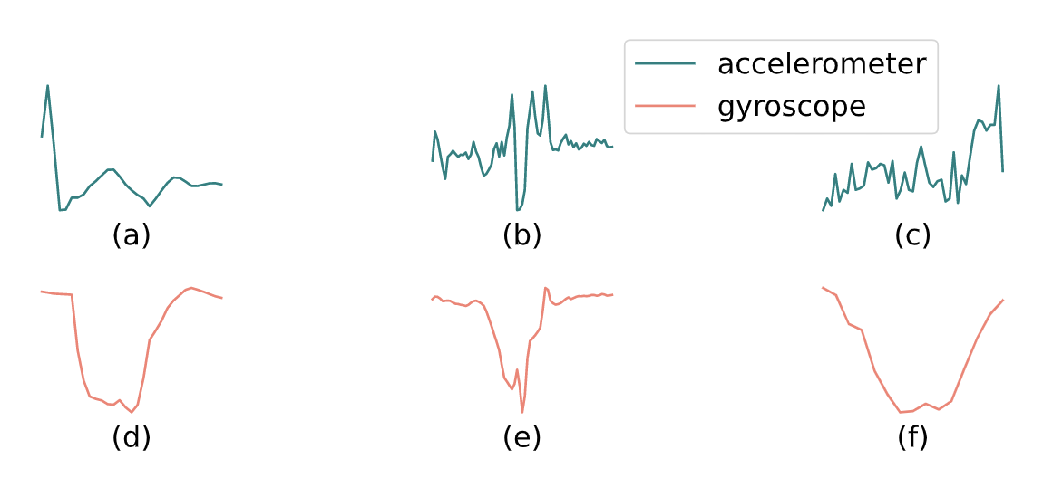
Insight 1: Using Gyroscope Data Only
Accelerometer data is noisy for blind users
Gyroscope drift can be a problem; but we focus on short gestures
Accelerometer
data
Gyroscope
data

Slide 13
Gesture Phases
Pre-stroke
Post-stroke
Nucleus

Slide 14
Insight 2: Identifying Invariant Micro movements “Nucleus”
The nucleus is the core of the gesture and is consistent across all users.

Slide 15
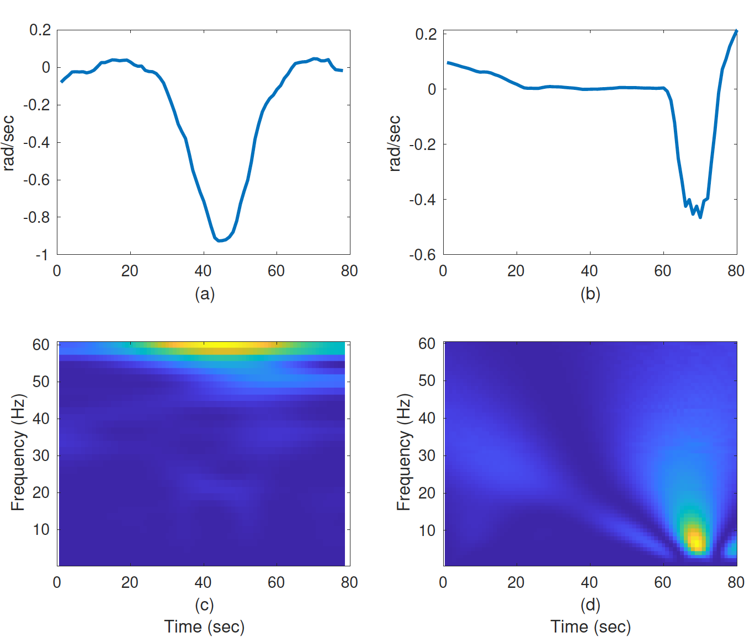
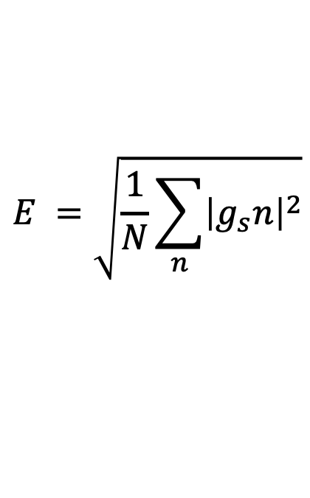
Nucleus Detection
Jitters
Pre-stroke
Post-stroke
Nucleus
$$E =\sqrt{\frac{1}{N}\sum_{n}{{\left|g_{s}n\right|}^{2}}}$$
Forearm gesture
Wrist gesture

Slide 16
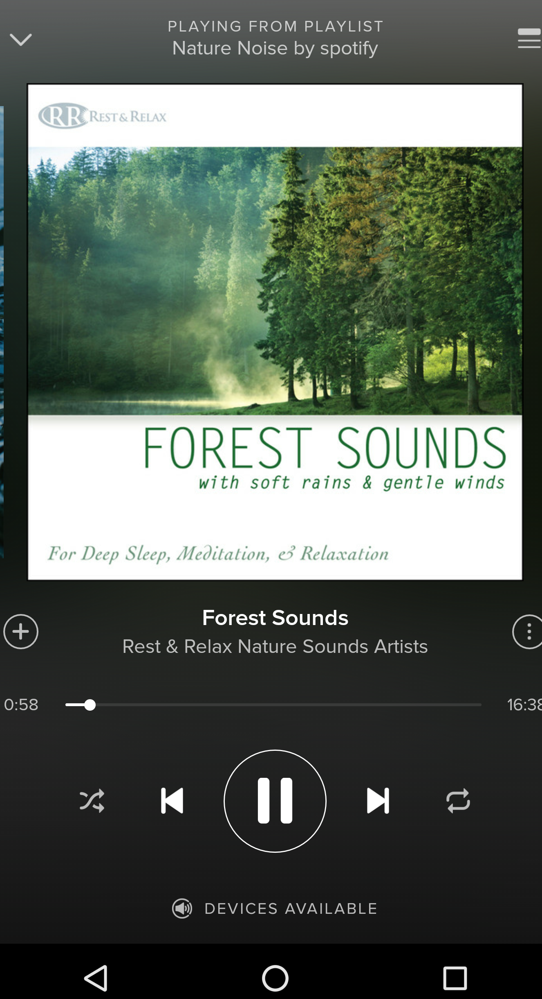
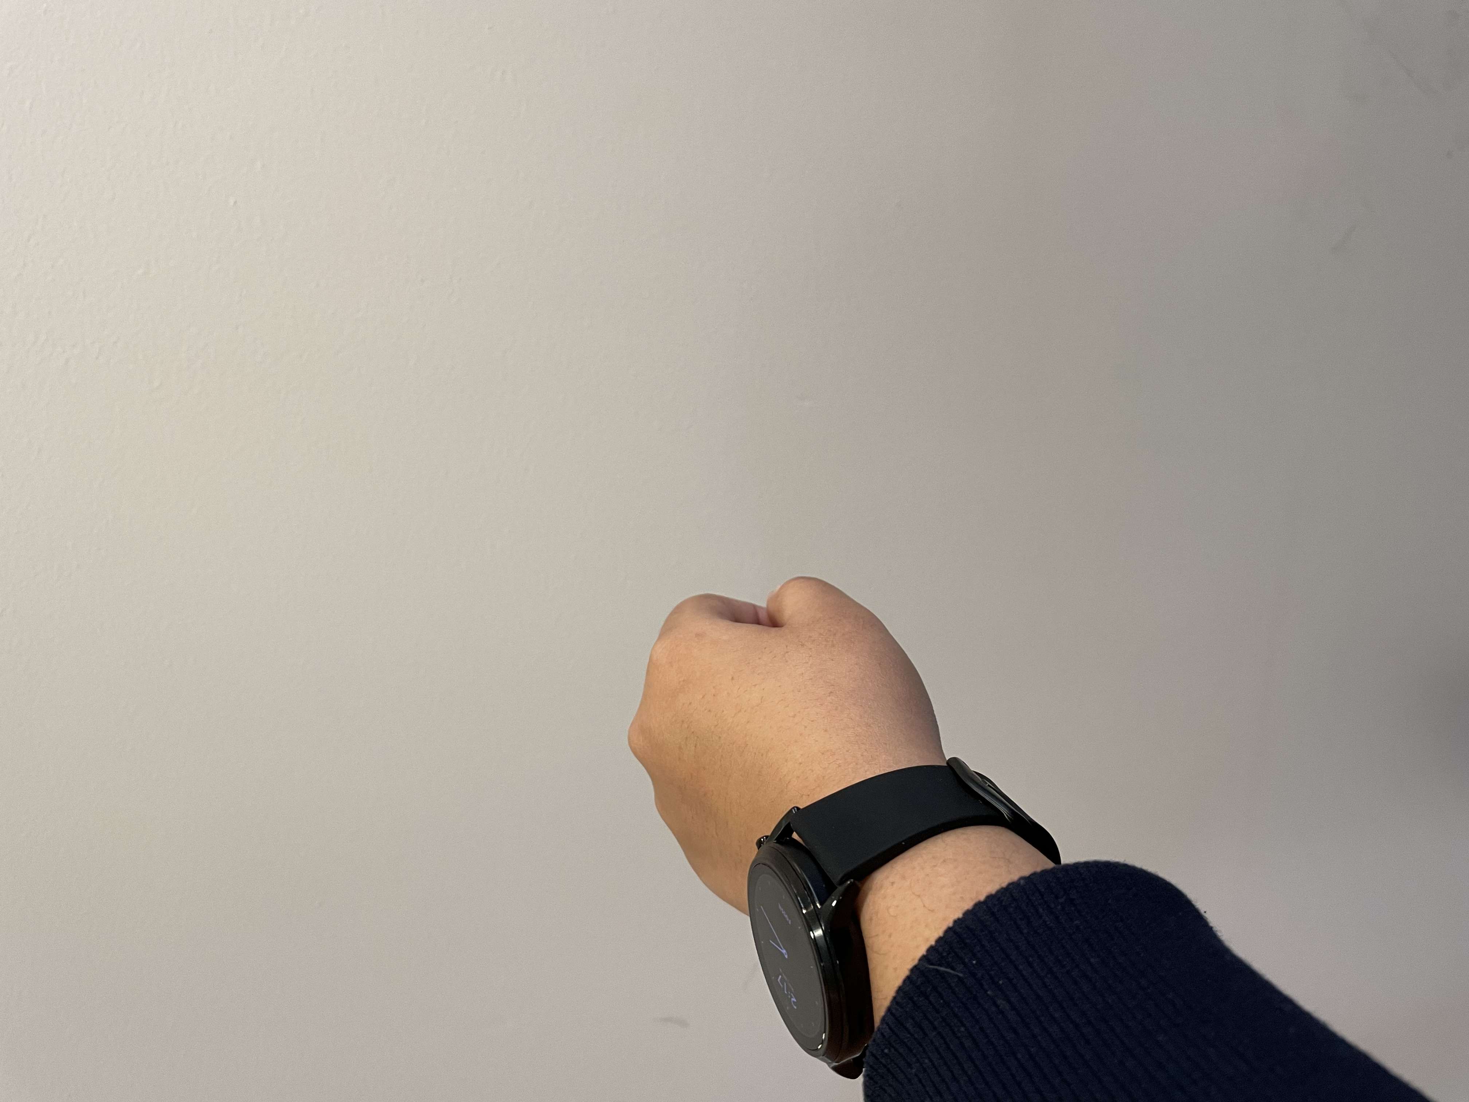
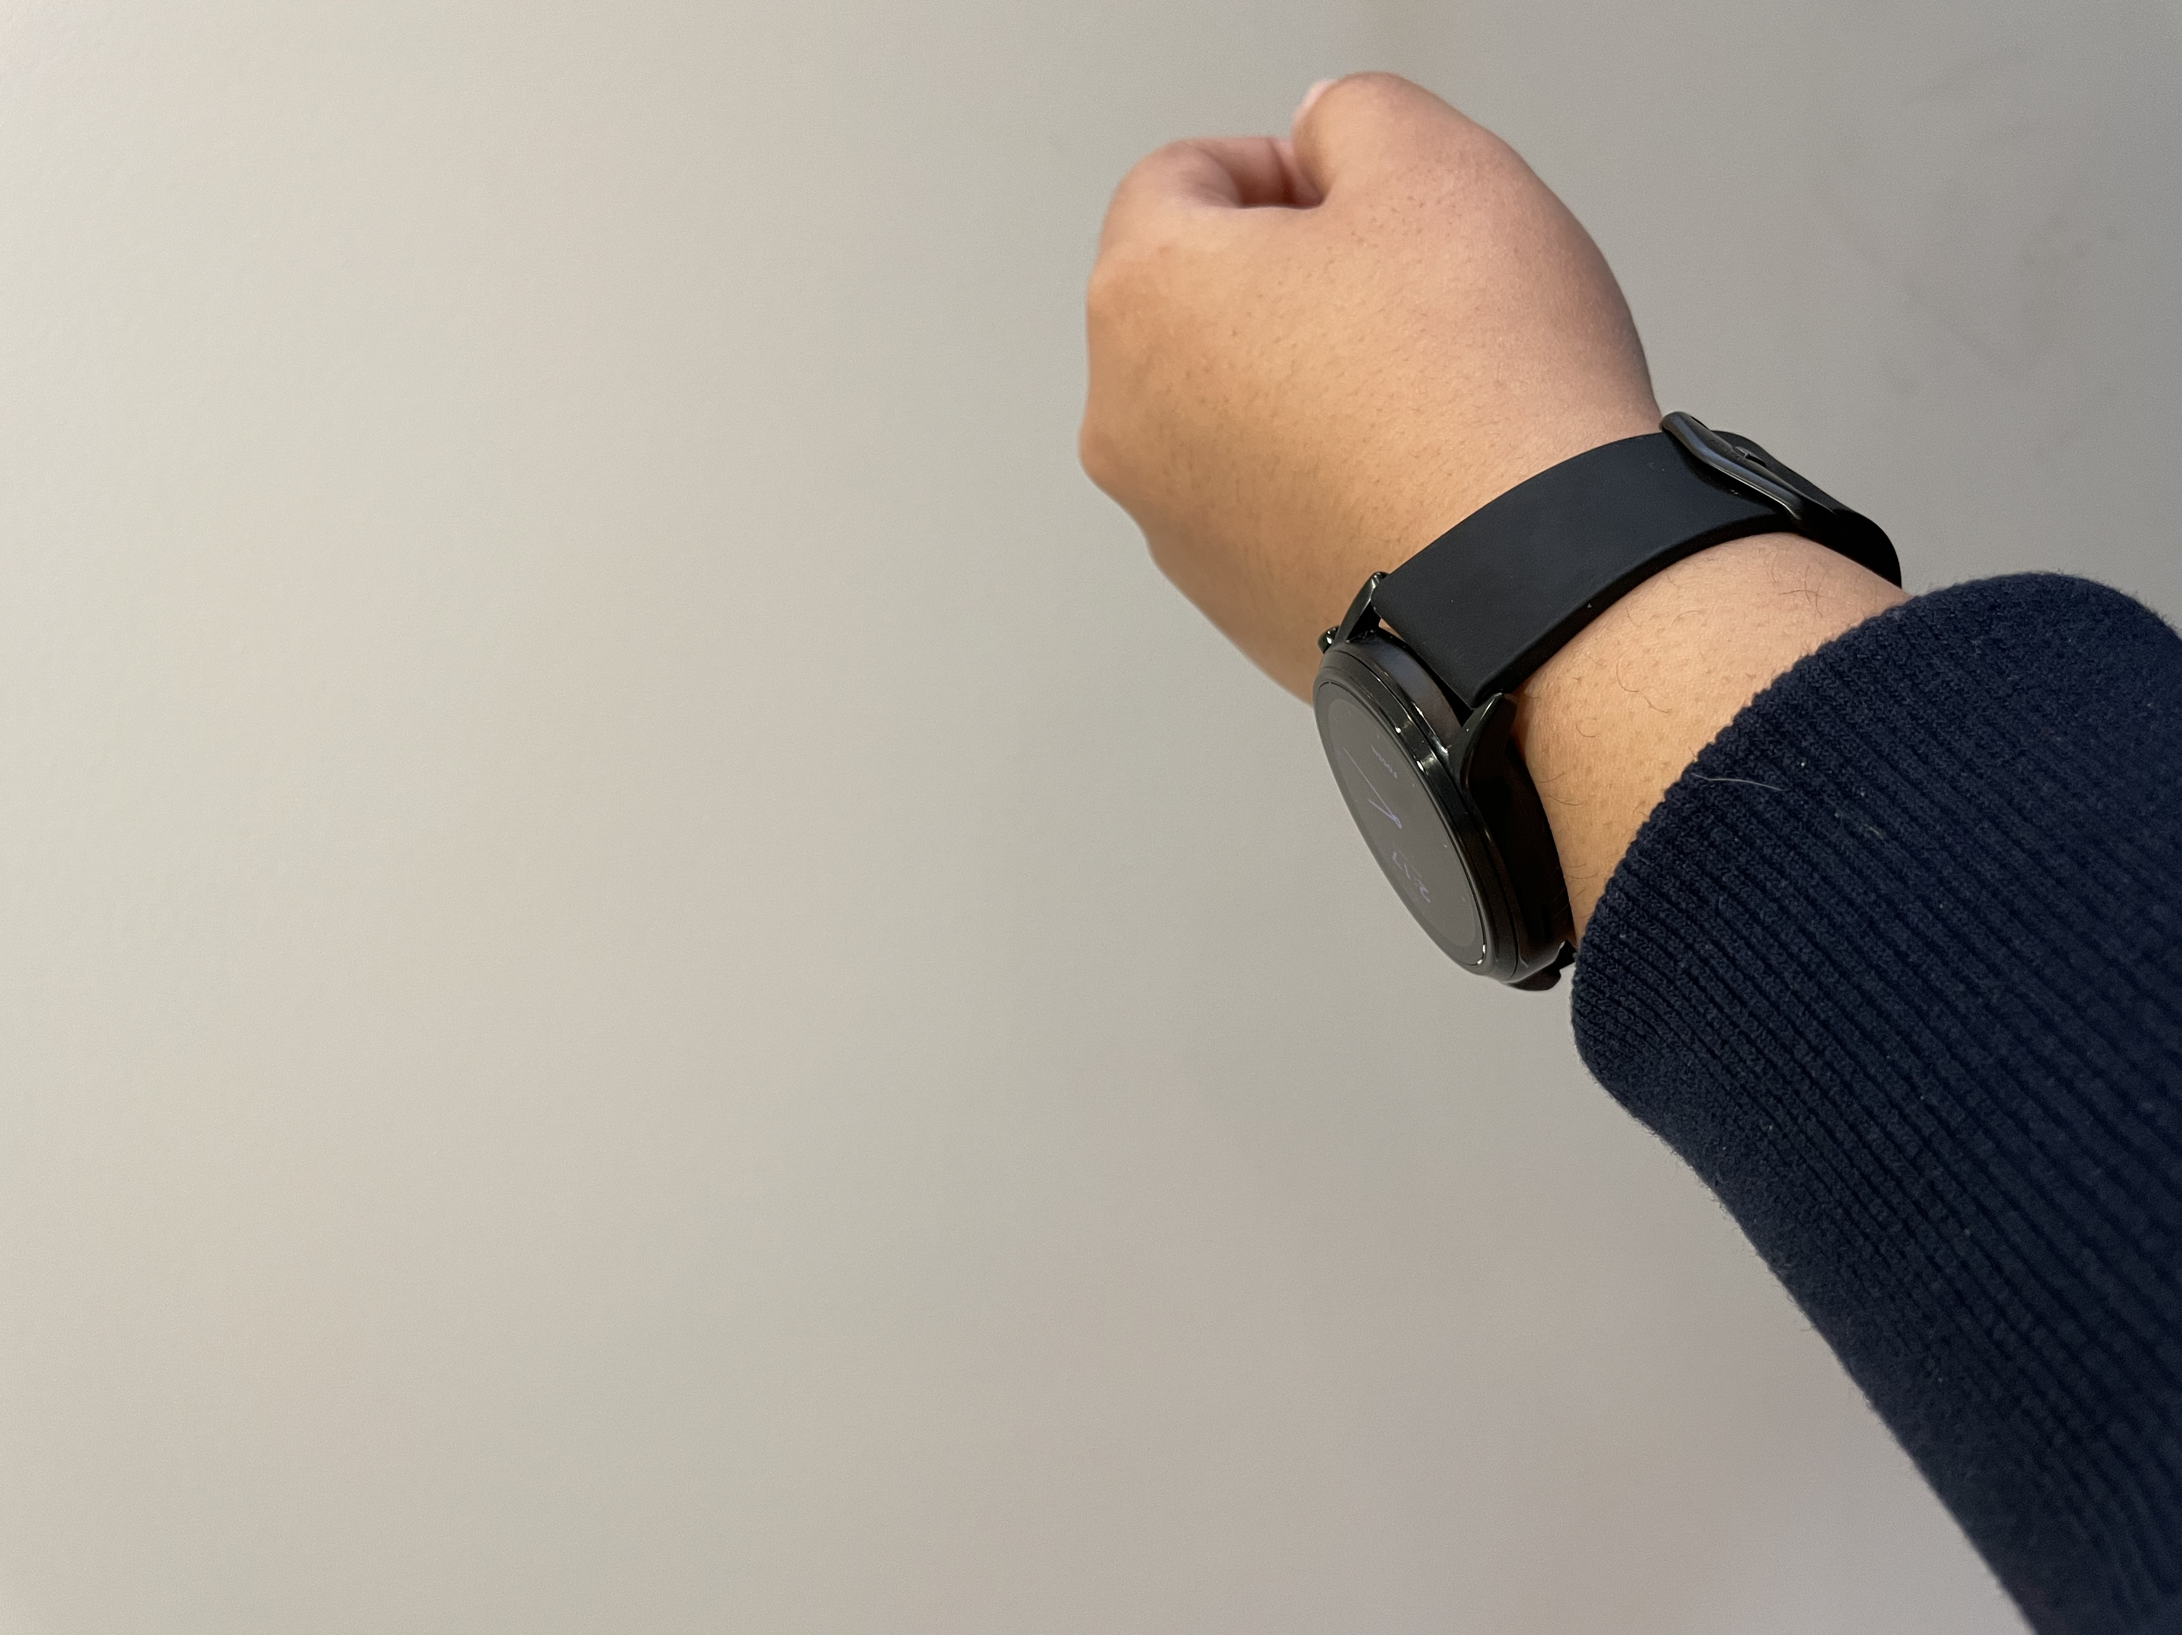
Gesture Replacement Challenges
Application logic and the interaction are coupled.
Integrating new gesture requires rewriting the application.

Slide 17
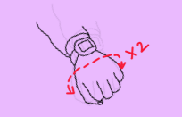
Gesture Replacement Insights

Slide 18
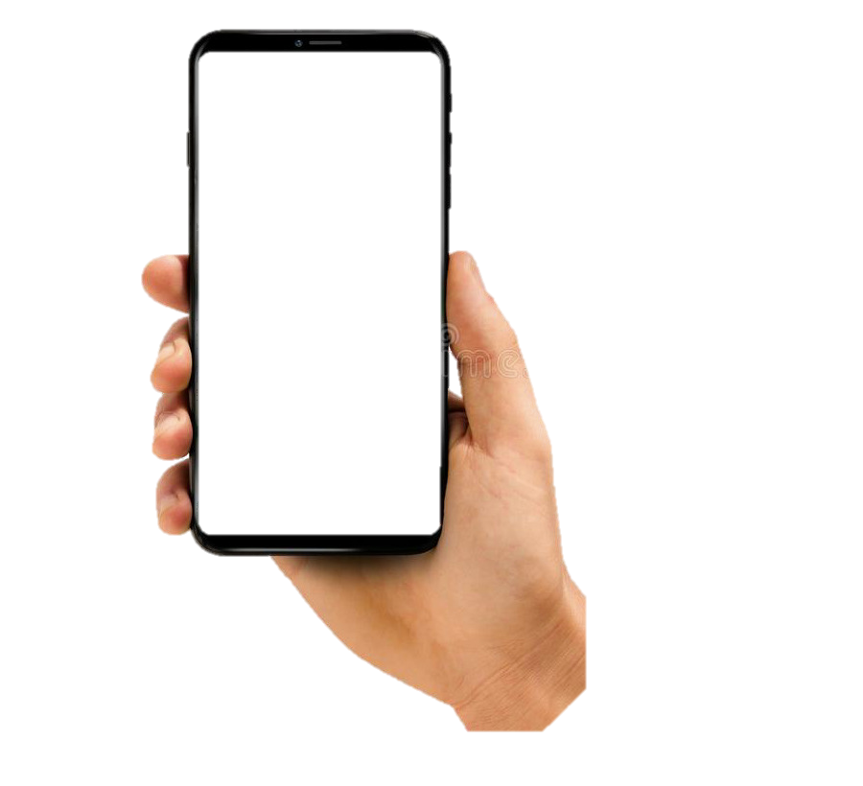
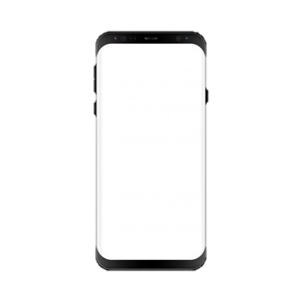
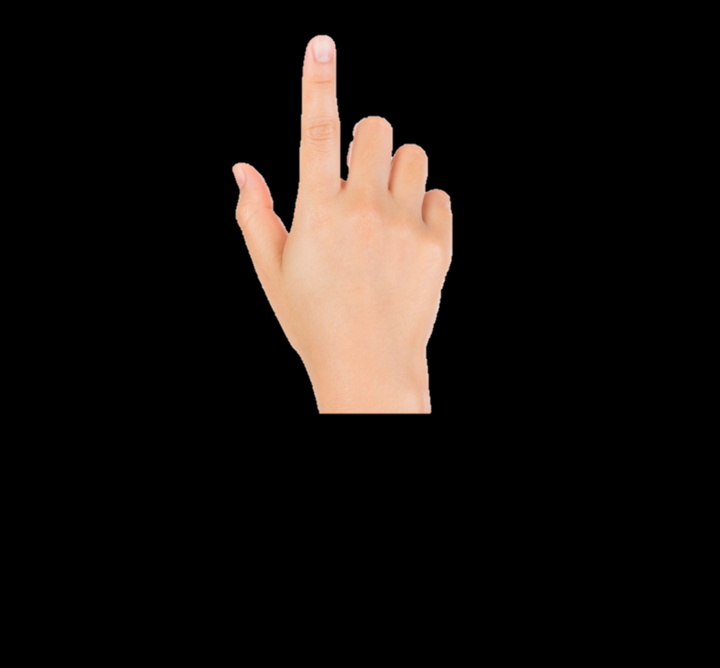
Input Virtualization: Decouple Application Logic from Input
User
Layer
Phone App
Record Touch Gesture
Swipe
Window Manager Service
Framework
Layer
[t₁, x₁, y₁]
[t₂, x₂, y₂]
……
Virtual Sensor Service
Sensor Service
Hardware
Layer
Replay Swipe
Virtual Touch
Sensor
Sensors
Record and Replay
Smartphone

Slide 19
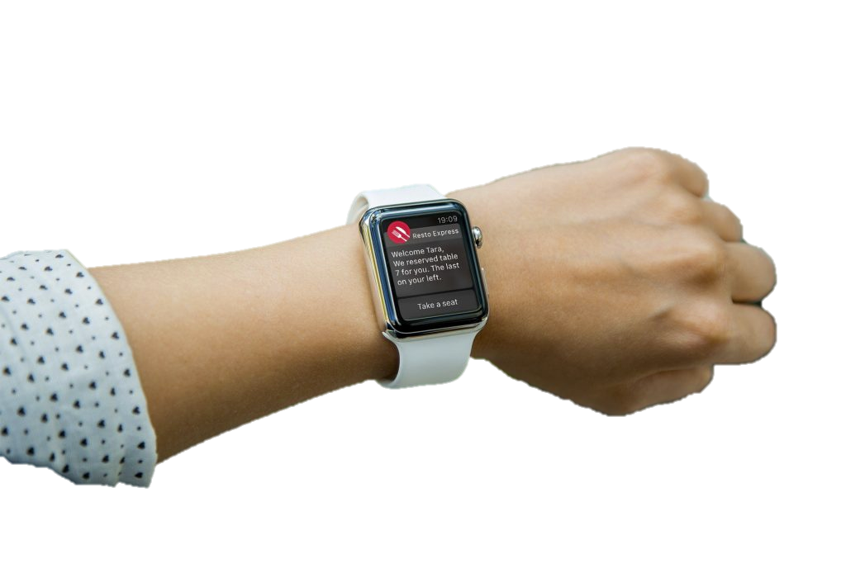
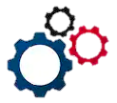
Metaprogram: Flexible Gesture Mapping
Metaprogram
Forearm-right
Next-Item
An alternate gesture can replace a touchscreen gesture for any application with zero changes to the application
GUI

Slide 20
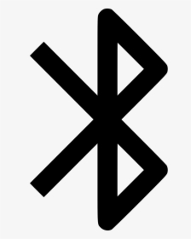
Run-time Implementation
Gesture Recognition
App
AccessWear
Phone Service
AcessWear
Watch Proxy
Mapping
Meta-
Program
Touch
Replayed
Gyroscope Sensor
Smart Watch
Touch Screen Hardware
Smart Phone

Slide 21
Real-World User Study
Real world user study (IRB approved) with 8 blind users.
  5 male and 3 female
  34-61 years of age
Designed a task: required a series of gestures.
Collect traces of 5 gestures performed 3 times for offline analysis.

Slide 22
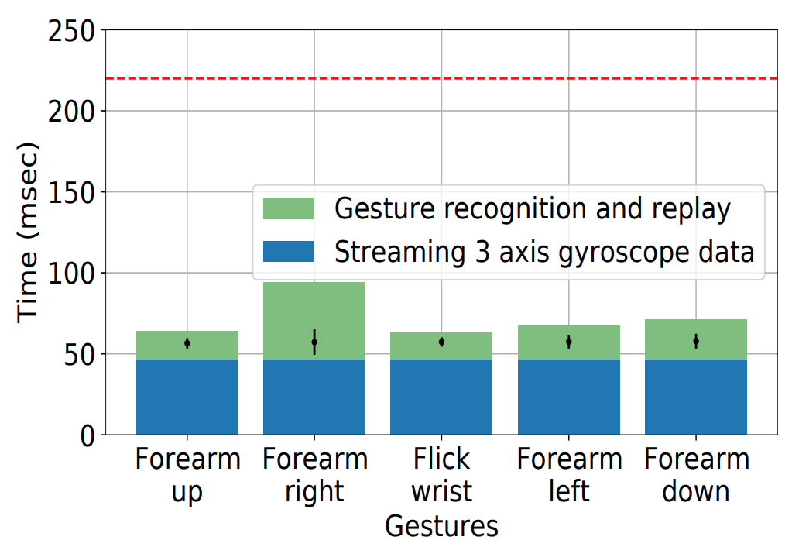
Latency for Gesture Recognition and Replay
220 msec reaction time of users¹
AccessWear works near real time.
¹Henry Hamburger. Donald RJ Laming. Information, theory of choice-reaction times. New York: Academic Press, 1968. 1969.

Slide 23
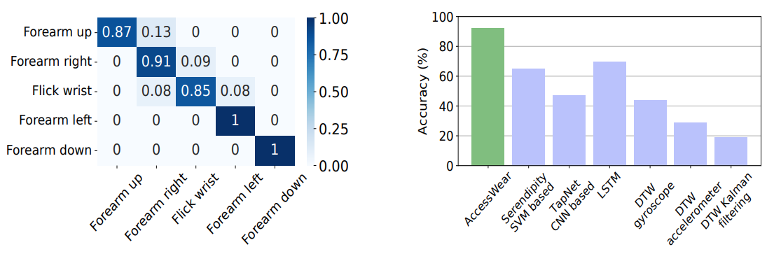
Gesture Recognition Accuracy
AccessWear is 92% accurate and outperforms other baselines for blind users even with limited data.

Slide 24
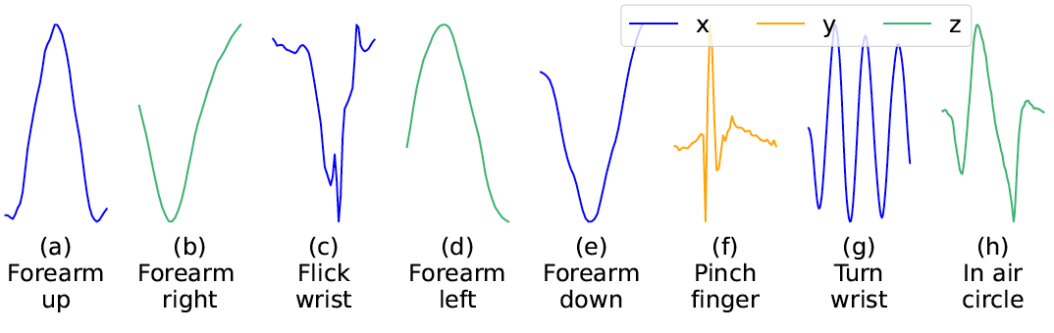
Extending AccessWear
We recruited 5 sighted users and added 3 more gestures.
.
93% gesture recognition
accuracy
Interacting with unmodified applications using alternate gestures: Spotify, YouTube, Gallery, and Browser

Slide 25
Summary
Developed AccessWear, a real-time smartwatch-based gesture recognition system for blind users without any training data.
Developed novel input virtualization mechanism that eliminates the need for each app to integrate alternate gestures.
Demonstrated with a real-world user study with blind users that AccessWear is 92% accurate.
https://github.com/SBUNetSys/AccessWear

