Slide 1


Towards Spatial Selection Transmission for
Low-end IoT devices with SpotSound
Tingchao Fan¹, Huangwei Wu¹, Meng Jin¹, Tao Chen², Longfei Shangguan², Xinbin Wang¹, Chenghu Zhou¹
¹Shanghai Jiao Tong University, China
²University of Pittsburgh, USA

Slide 2
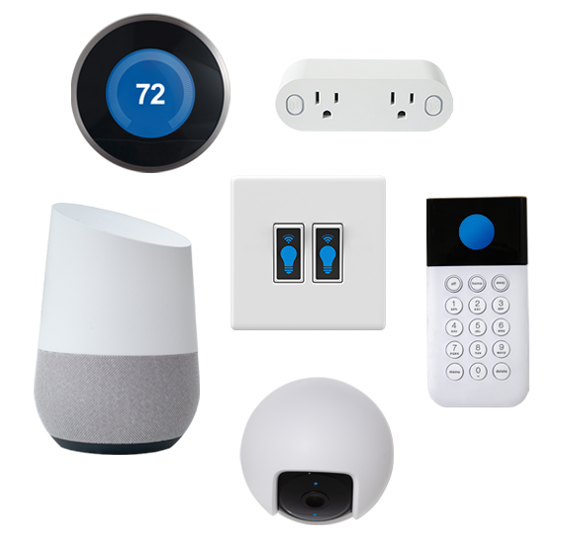
IoT devices are prevalent nowadays
The broadcast nature of the wireless channel brings a lot of privacy concerns
2

Slide 3
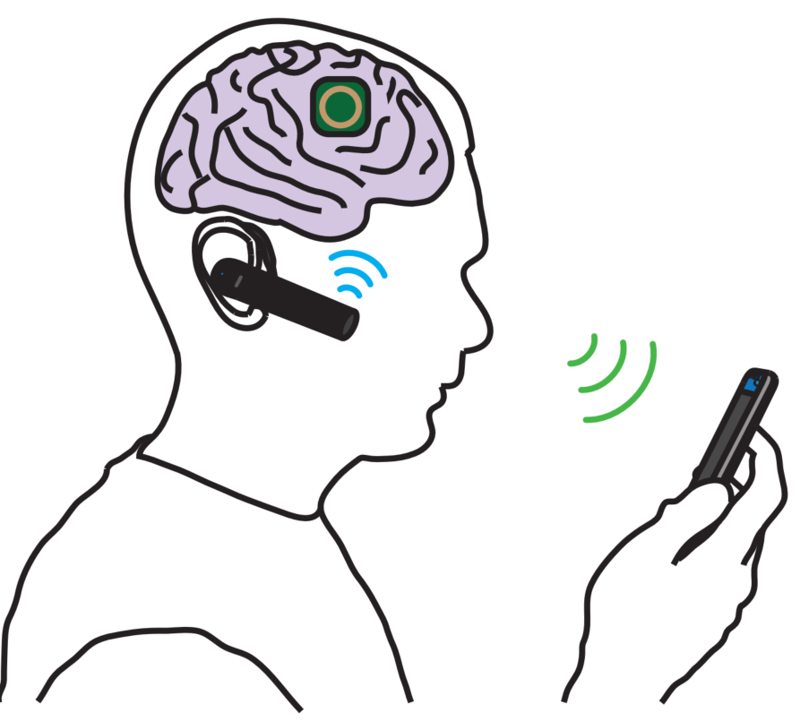
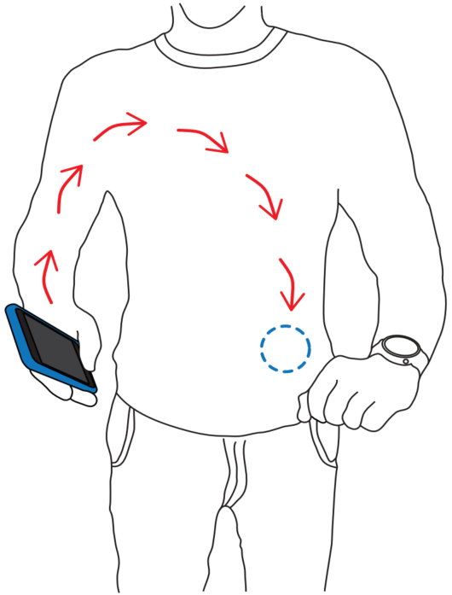
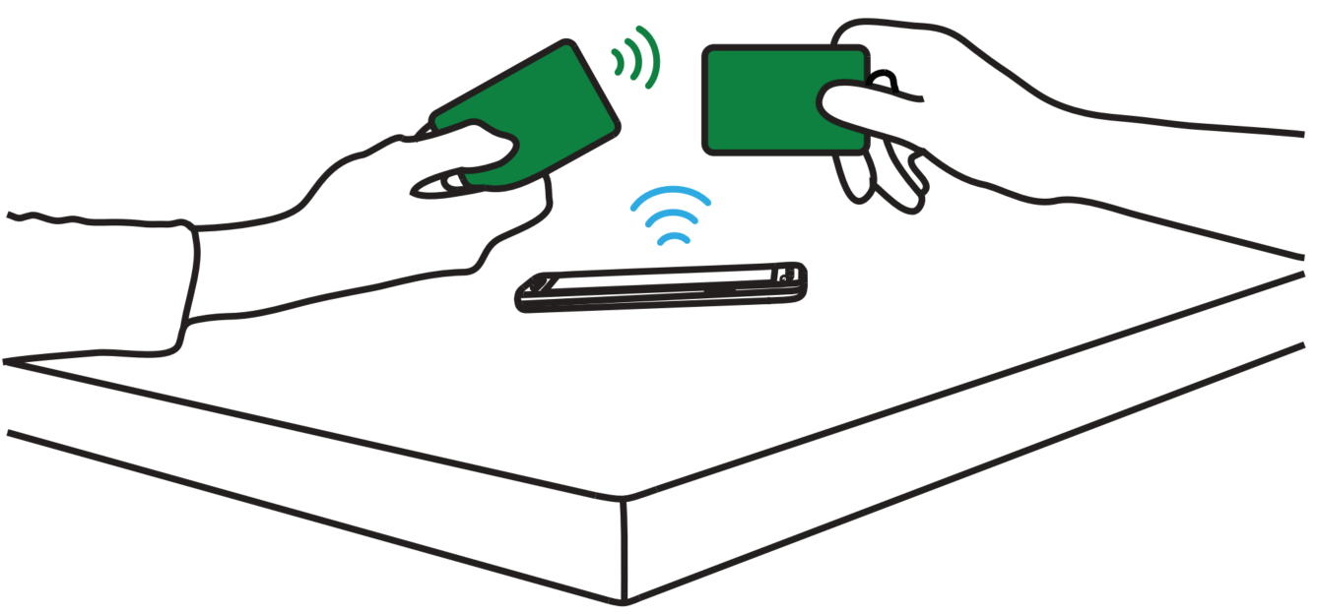
Potential Privacy Risks
Activity
Health condition
Trade information
Private information shared among IoT device
3

Slide 4
Potential Privacy Risks
Activity
Health condition
Motion
Trade information
Location
Private information shared among IoT device
Side channel information from the signal itself
Can we achieve spatial-selective transmission?
4

Slide 5



Large quantity of deployed tags
Existing Solution: Beamforming
????
Eavesdropper
Sender
Directional beam
Receiver
5

Slide 6
Large quantity of deployed tags
Existing Solution: High Hardware Cost
……
Antenna array
Directional beam
Too costly to deploy on IoT devices
6

Slide 7
Large quantity of deployed tags
Existing Solution: High Hardware Cost
……
Metasurface
Antenna array
Directional beam
Directional beam
Too costly to deploy on IoT devices
High infrastructure cost
7

Slide 8

SpotSound: Single Antenna Beamforming
with Single Speaker and Single Microphone
Focus signal on a Spot
8

Slide 9
The idea of SpotSound
Indoor Environment
Natural Beamformer !
9

Slide 10
The idea of SpotSound
Power Delay Profile
10

Slide 11


The idea of SpotSound
$$R_{B}\left(t\right)=h_{B}\left(t\right)⊗s\left(t\right)+w(t)$$
$$R_{E}\left(t\right)=h_{E}\left(t\right)⊗s\left(t\right)+w(t)$$
Different Locations
Different Multipath Channels
11

Slide 12
The idea of SpotSound
$$R_{B}\left(t\right)=h_{B}\left(t\right)⊗s\left(t\right)+w(t)$$
$$R_{E}\left(t\right)=h_{E}\left(t\right)⊗s\left(t\right)+w(t)$$
Considering the wireless channel as a
location-dependent filter
12

Slide 13

The Idea of SpotSound
Find a modulation method so that the embedded information can pass through only the target "filter“.
Target channel
0011……
Modulated signal
Other channel
???
Channels
13

Slide 14
The Idea of SpotSound
Finding the unknown mapping
Find a modulation method so that the embedded information can pass through only the target "filter“.
Target channel
0011……
Modulated signal
Other channel
???
How to Find the right way for modulation based on how the target channel will impact the transmitted signal ?
Channels
14

Slide 15
The Idea of SpotSound
Identify distinctive characteristics of a target channel
Uncover how these characteristics impact the signal waveform
Modulate the transmitted signal to make it decodable only after the target channel
Finding the unknown mapping
Target channel
0011……
Modulated signal
Other channel
Challenging Task !
???
Channels
15

Slide 16
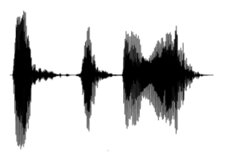
Deep Learning-based Communication
Transmitter
Receiver
Delay profile
0101
Target channel
Carrier
(noise signal)
Non-target channel
????
0101
Eavesdropper
Embed data on noise
Make data only detectable on the target channel
16

Slide 17
Deep Learning-based Communication
Transmitter
Receiver
Delay profile
0101
Target channel
Carrier
(noise signal)
Non-target channel
????
0101
Eavesdropper
Guide transmitter to generate satisfying signals
Check whether the signal is decodable on each channel
17

Slide 18
Deep Learning-based Communication
Transmitter
Receiver
Delay profile
0101
Target channel
Carrier
(noise signal)
Non-target channel
????
0101
Eavesdropper
Generate signals in a channel-selective manner
18

Slide 19
SpotSound’s model
G
Features
19

Slide 20



SpotSound’s model
Resistant to the impact of the target channel
$$⨂h_{B}\left(t\right)$$
0101
G
0101
$$⨂h_{E}\left(t\right)$$
???
Features
Vulnerable to other channel
20

Slide 21
SpotSound’s model
Power delay profile of the target channel
$$⨂h_{B}\left(t\right)$$
0101
G
0101
$$⨂h_{E}\left(t\right)$$
???
Features
How could the generator know which features can be used to embed the data for a certain target channel?
21

Slide 22
Model Training
Alice
①
②
①
Bob
②
$$⨂h_{B}\left(t\right)$$
③
Bob
0101
G
Carol
③
Carol
Alice
$$⨂h_{E}\left(t\right)$$
???
① Alice to Bob Channel
② Bob to Alice Channel
③ Alice to Carol Channel
Measure reciprocal channels between Alice and Bob and use them respectively as Alice’s input and Bob’s channel.
22

Slide 23

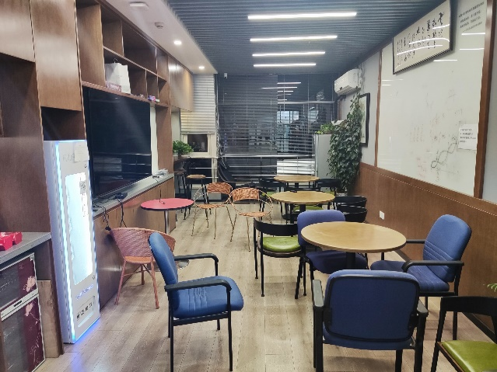
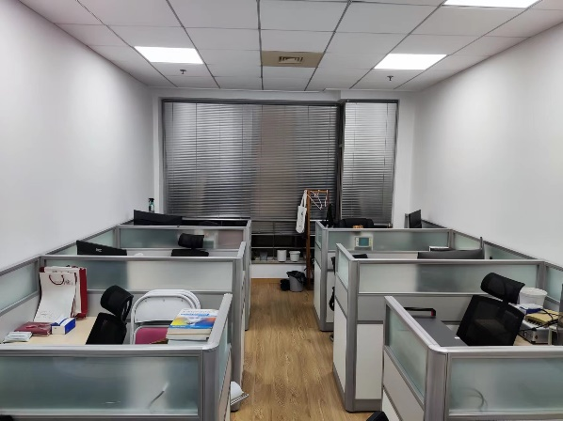
Model Training
Alternation between Alice/Bob and Carol
Bob
Bob
Alice
Alice
Carol
Carol
Data collection: 430,000 delay profiles from 12 different indoor rooms.
……
23

Slide 24
Practical problems
Detected once overlap >40%
Alice
0
0
0
1
Alice-to-Bob
Noise signal
Bob
Bob-to-Alice
Modulation
signal
Carol
Alice-to-Carol
Move with a larger step
Packet
Detector
0 or 1
Different measured channels
Channel Estimation : obtain the delay profile of the target channel with channel reciprocity
Packet Detection: detect signal at legitimate receiver with a binary classifier
Details can be found in the paper
24

Slide 25
Evaluation
25

Slide 26
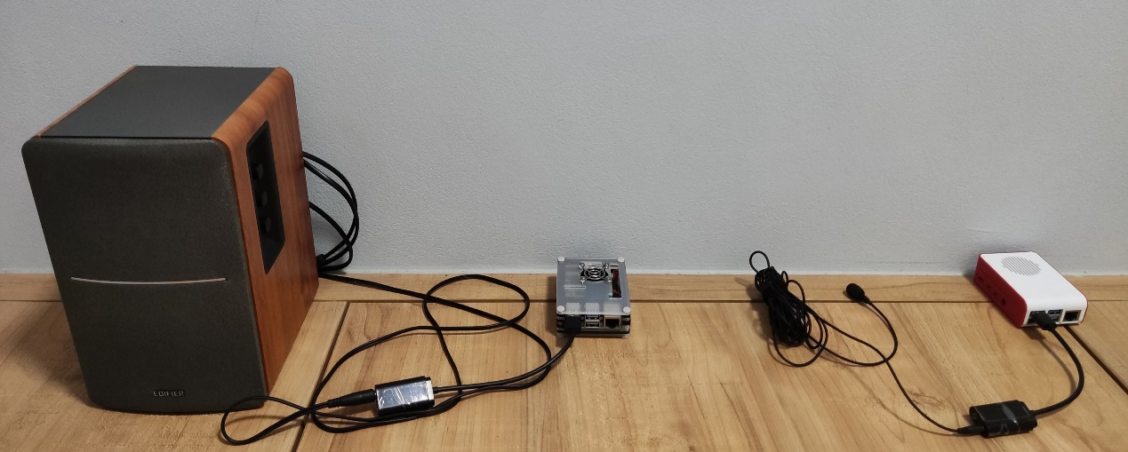
Implementation
Hardware
Speaker
Sound card
Raspberry pi
Mic
Raspberry Pi 4 Mode
EDIFIER R1200TII speaker
TakStar TCM-400 microphone
Model
Model | Description | Memory | Computation
I | DSC | 1,234,743 | 100.84 MFLOPS
II | LRA+DSC | 549,795 | 26.71 MFLOPS
III | LRA+DSC+Pruning | 188,467 | 22.16 MFLOPS
Implement 3 compression technologies
DSC: Depth-wise separable convolution
LRA: Low-rank approximation
Pruning
Alice & Bob: Model III
85%
78%
26

Slide 27
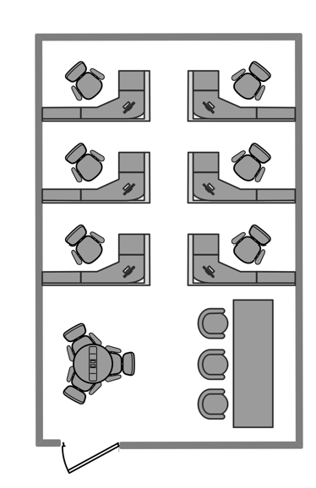
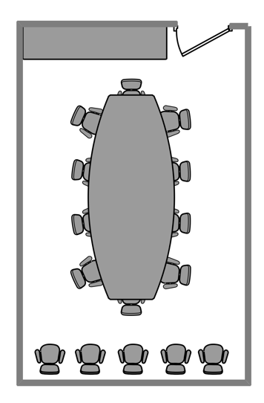
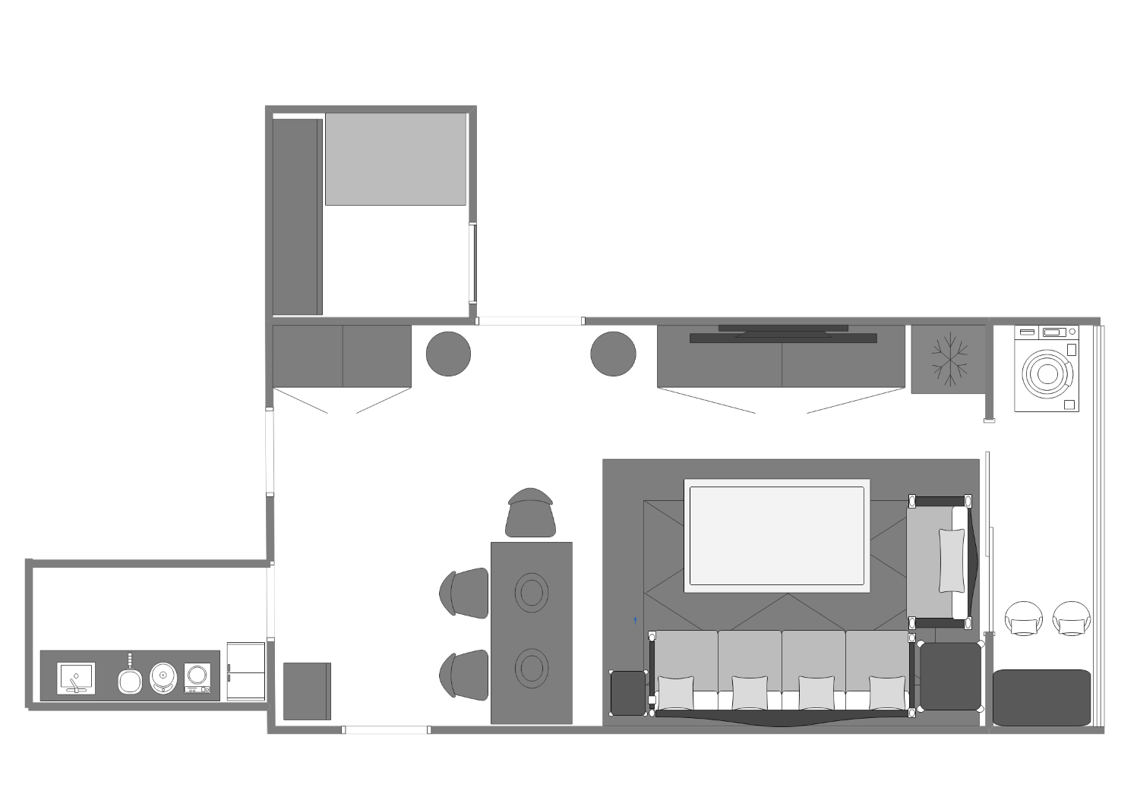

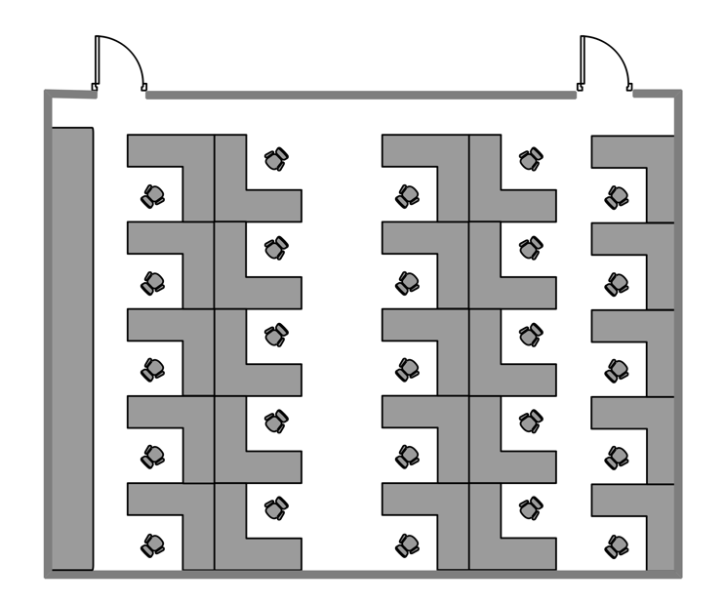
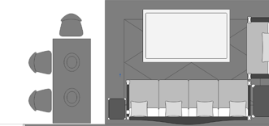
Setting
Scene 5: Meeting room
Scene 6: Small office
Evaluate in 7 unseen rooms
3.5m
3.5m
Scene 2: Study room
8.3m
8.3m
Scene 7: large office
Scene 1: Living room
EVE
Scene 3: Balcony
7.6m
Bob
Alice
2m
Scene 4: Kitchen
4m
7.8m
Apartment
Office
27

Slide 28
SpotSound can always focus the signal on a no more than 0.25m² spot
Overall performance
1m²
(a-1)
(a-2)
(a-3)
(a-4)
Sender
1m²
Target Receiver
Non-target Receiver
(b-1)
(b-2)
(b-3)
28

Slide 29
Impact of model complexity
There is no obvious performance gap between Model III and the other two models, although its size is reduced by nearly 85% compared with Model I
Bob
EVE
29

Slide 30
Impact of direction and distance
SpotSound’s communication distance can achieve at least 6m.
Transmission Direction
30

Slide 31
Conclusion
We for the first time achieve spatial-selective transmission by leveraging a single speaker.
We reveal that deep learning is good at optimizing objectives in wireless communication which is hard to achieve with hand-craft algorithms.
We implement SpotSound on low-end devices and show its ability to concentrate its signal in a less than 0.25𝑚² spot.
31

Slide 32
Thanks You !
Q & A

