Slide 1


MagCode: NFC-Enabled Barcodes for
NFC-Disabled Smartphones
ACM MobiCom 2023
Donghui Dai, Zhenlin An, Qingrui Pan, Lei Yang
The Hong Kong Polytechnic University

Slide 2



Background
Security!
User-friendly!
No alignment requirement!
Voice assistants are NOT always safe!
Barcode-based Payment
NFC-based Payment
Contactless Payment is Booming in Post-COVID World

Slide 3

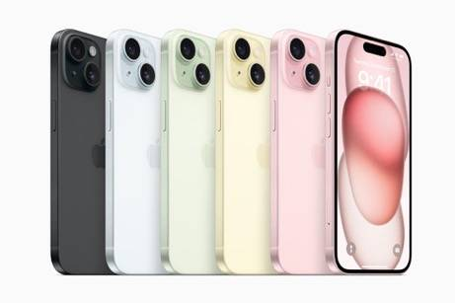
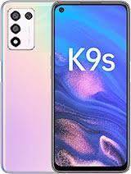
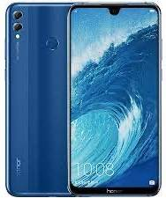



Motivation
About 80% of the global population does not use NFC function in their cellphones today [1]
iPhone Series
OPPO K9S
Honor 8x Max
NFC-supported Smartphone
NFC-unsupported Smartphone
Not All Cell Phones Support NFC Function
[1] “Worldwide NFC Technology Use Surges Over Last 24 Months,” 2022.

Slide 4
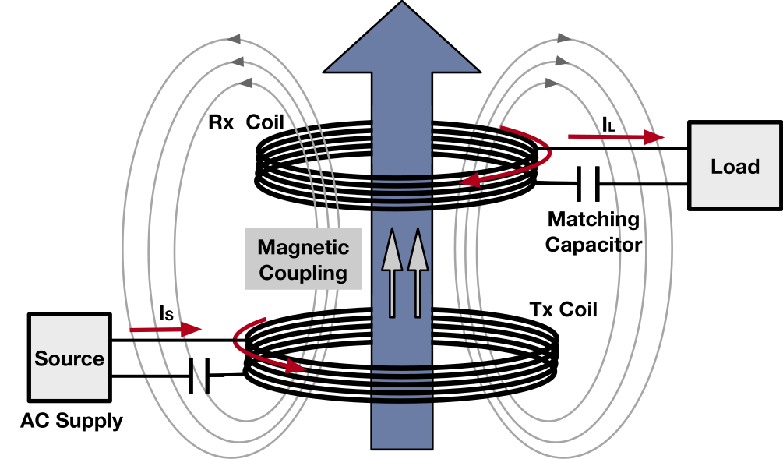
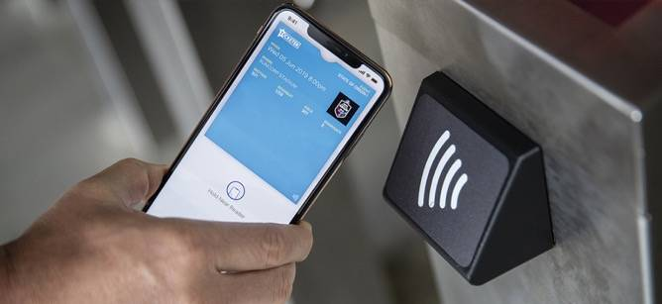
Our Findings
Cameras suffer from magnetic interference
generated by an NFC reader!
NFC Usage: Tap & Go
NFC Principle: Magnetic Coupling
Tap Cellphone Camera on the NFC Reader

Slide 5
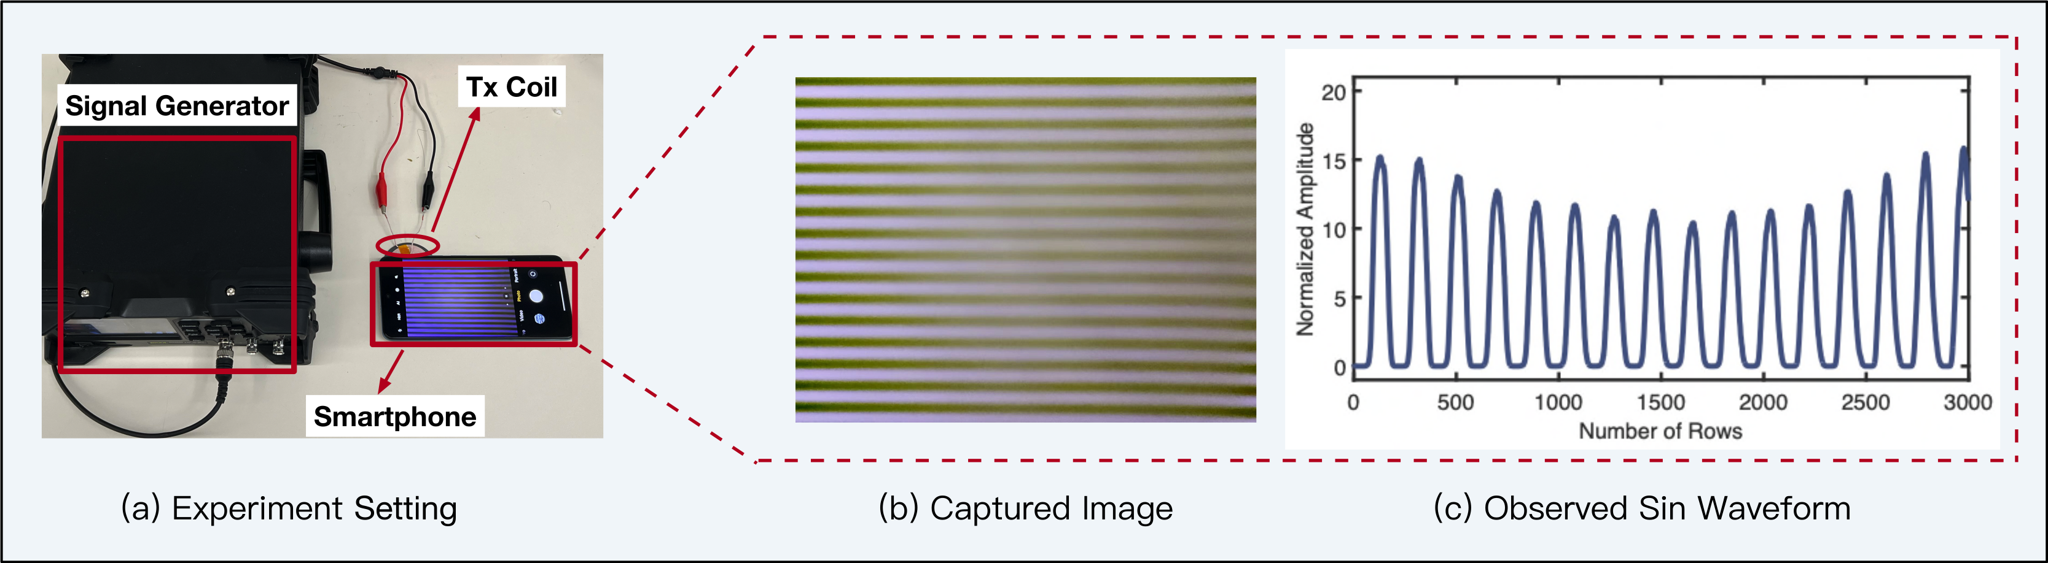
Our Findings
The image shows alternant stripes when the camera is close to an NFC reader due to the magnetic interference

Slide 6
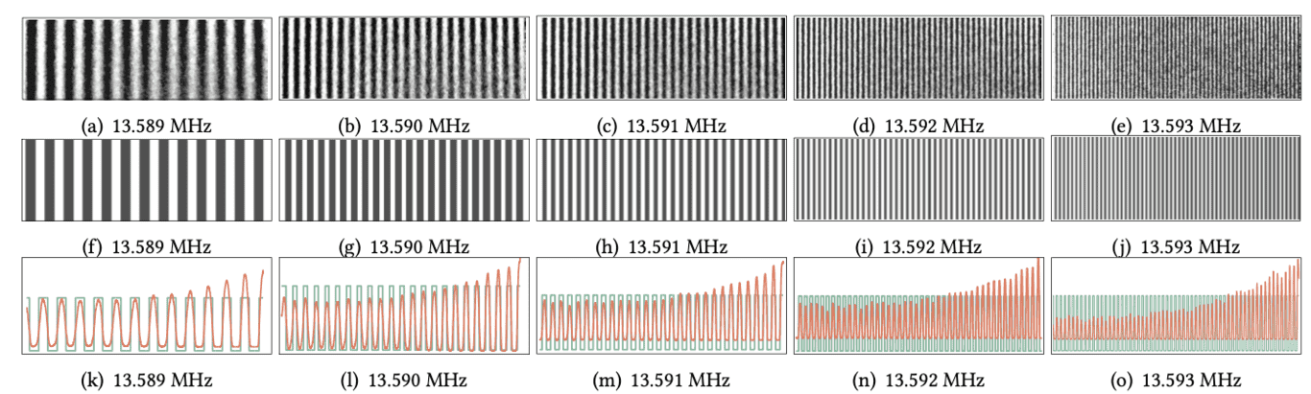

Our Findings
Frequency Increasing
Dense Strips Appear
Magnetic-inductive Barcode-like Strips on Captured Images

Slide 7
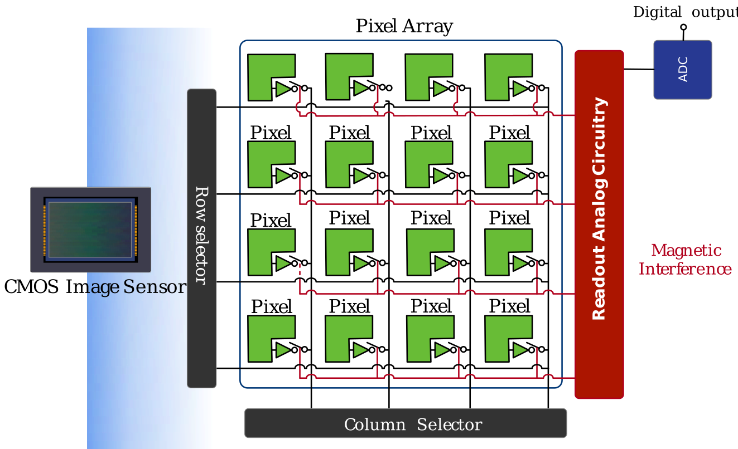

Why Alternant Strips?
Read out line by line
The magnetic field imposes interference on the image line-by-line due to image sensor’s line-wise readout mechanism!

Slide 8
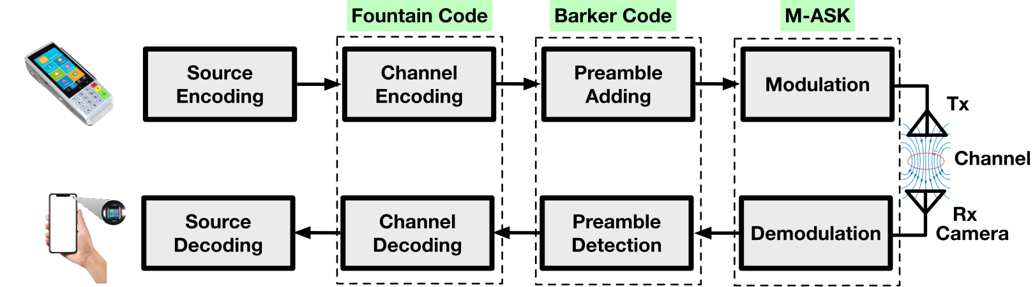
Proposed Communication
Achieving a simplex communication from an NFC reader to a camera, akin to scanning barcodes!

Slide 9
Demo Video
https://donghui-dai.github.io/magcode/

Slide 10
MagCode
Challenge 1: How to distinguish phone models?

Slide 11
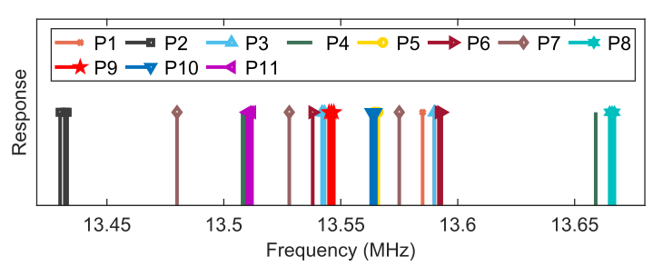
Challenge 1
Response frequencies across 11 different phone models were tested. Their optimal response frequencies are as follows:
Challenge: Different phone models exhibit slightly different optimal magnetic-sensitive frequencies!

Slide 12
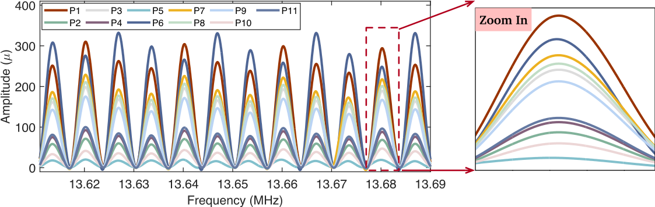
Our Solution
Use the frequency response as unclonable physical fingerprints to distinguish different phones
A simple KNN classifier achieves 95.6% average accuracy

Slide 13
Challenge 2: How to modulate bits via magnetic interference?

Slide 14
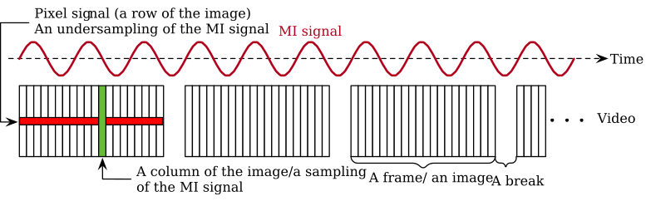
Challenge 2
The stripes are viewed as the result of under-sampling of the magnetic signal (500kHz readout vs 13.56MHz MI).

Slide 15
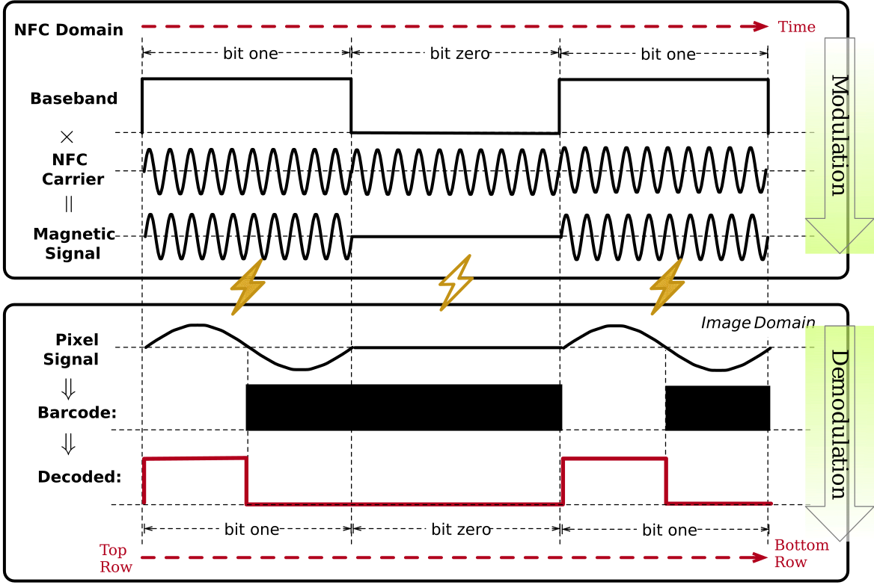

Our Solution
Modulation Scheme:
On-off Keying Modulation
Bit 1: with MI signal
Bit 0: without MI signal
Bit 1: w/ MI-enabled strips
Bit 0: w/o MI-enabled strips
The presence or absence of MI represents bit one or bit zero

Slide 16
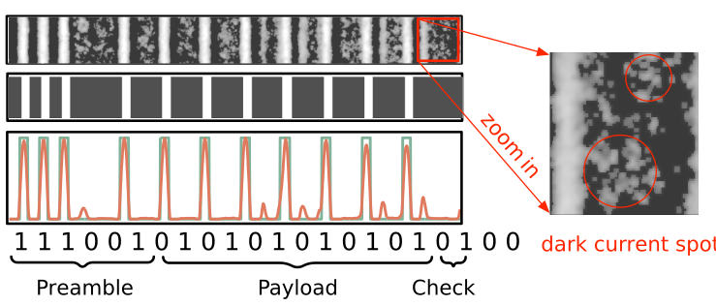
Our Solution
Modulation Scheme: On-off Keying Modulation
Example: A magnetic interference-enabled data packet

Slide 17
MagCode
Challenge 3: How to ensure data integrity without ACK?

Slide 18
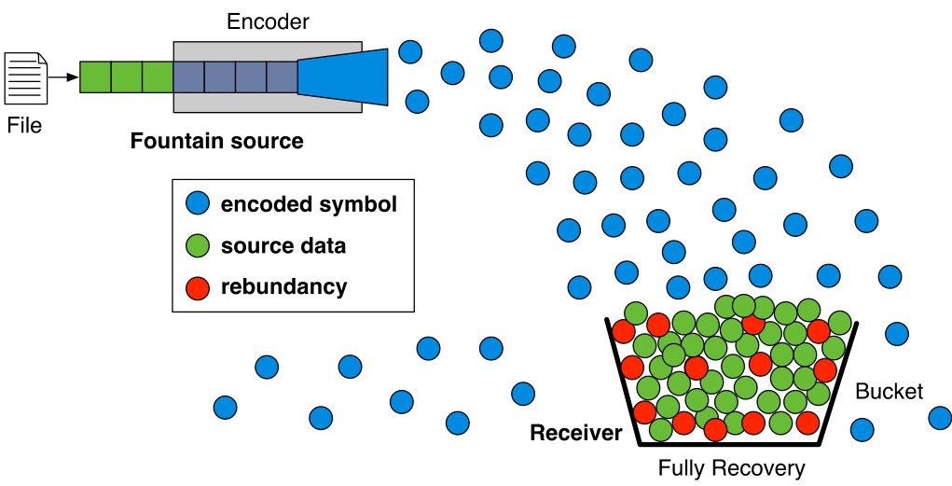
Fountain Codes
Data can be fully recovered with high probability given sufficient transmissions

Slide 19
Implementation & Evaluation

Slide 20
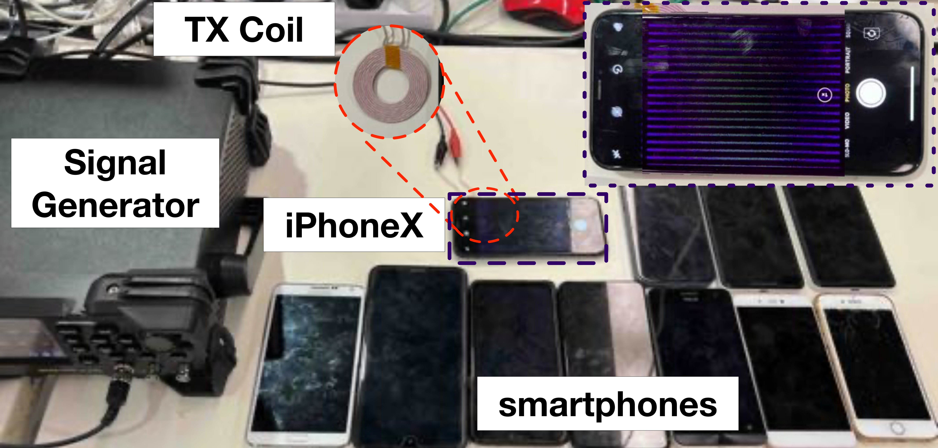
Implementation
Experiment Setting
A mobile app is developed for the smartphone to receive the NFC-enable magnetic data packet.

Slide 21
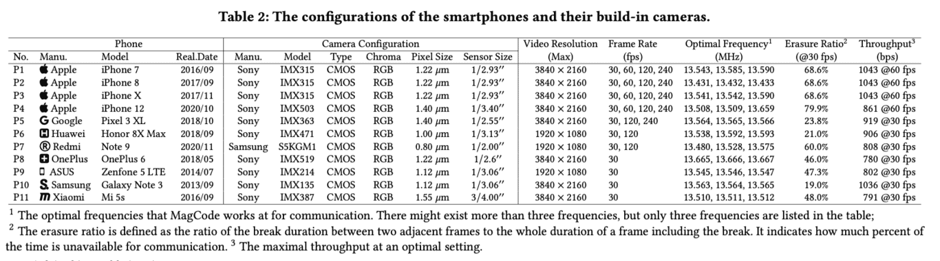
Feasibility Results
MagCode system was successfully tested in 11 smartphones

Slide 22

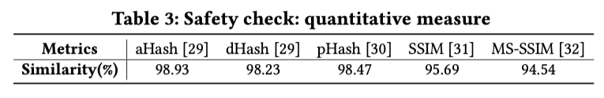
Safety Check
MagCode does not damage the camera sensor
The average similarity score between two images across different metrics is 97.2%

Slide 23
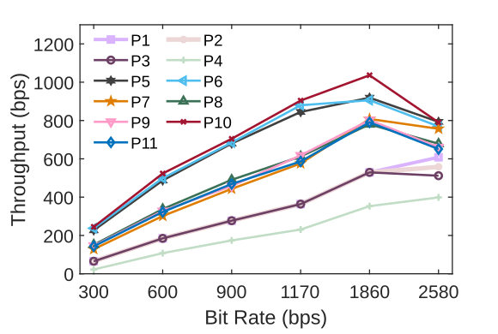
Throughput
Even in a worse case P4, the communication throughput is 400 bps, which is sufficient to transmit an entire QR code V2 in less than 1s.

Slide 24
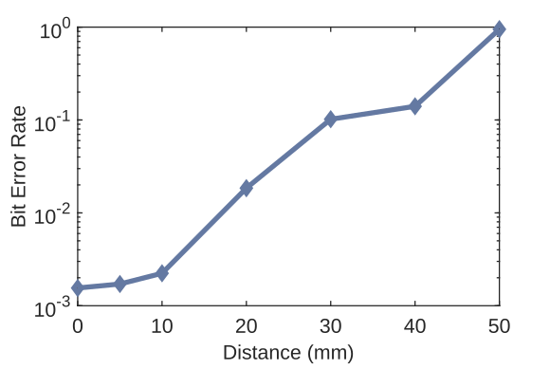

Bit Error Rate
The BER increases as the increase of distance.
(BER < when distance < 20 mm )

Slide 25
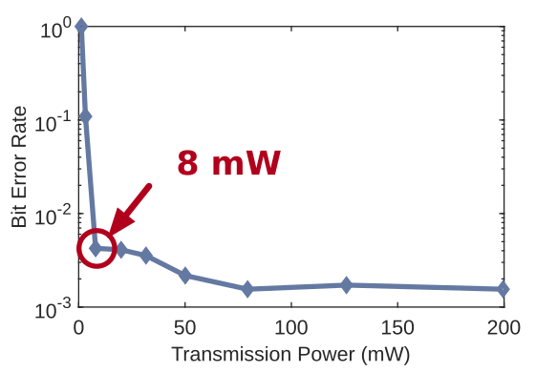
Impact of Transmit Power
MagCode (50 mW) is more energy-efficient than conventional NFC (100 mW)

Slide 26
Impact of Distance
The BER increases as the increase of distance.
(BER < when distance < 20 mm )

Slide 27

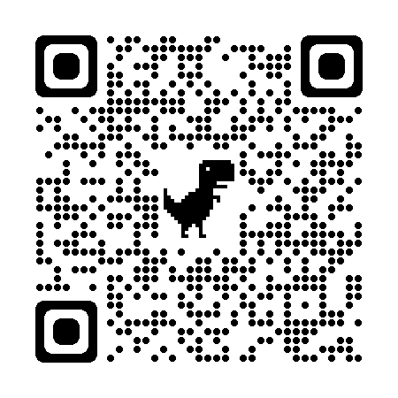
Conclusion
We first propose a novel cross-technology communication system between an NFC reader and the camera.
We demonstrate the feasibility and safety of such communication across mainstream smartphone models.
We design and implement a stack of protocols to achieve such a simplex communication.

Slide 28
Thank You!
https://donghui-dai.github.io/magcode/

