Slide 1


LiT: Fine-grained Toothbrushing Monitoring with Commercial LED Toothbrush
Kaixin Chen (SZU), Lei Wang (SZU), Yongzhi Huang (HKUST(GZ)), Kaishun Wu (HKUST(GZ)), and Lu Wang* (SZU)
MobiCom 2023
Notes:
Thank you for the introduction. Good afternoon, everyone. I am Kaixin Chen from Shenzhen University. I am excited to present our work, entitled LiT: fine-grained toothbrushing monitoring with commercial led toothbrush. This work is in collaboration with Lei Wang, Yongzhi Huang, Professor Kaishun Wu and Professor Lu Wang.

Slide 2
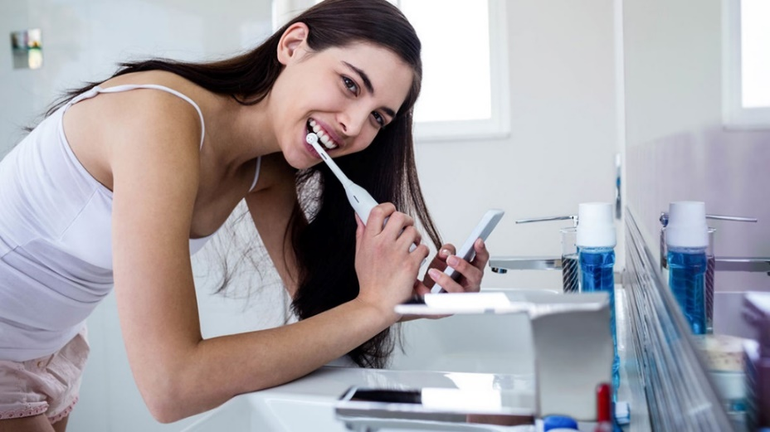
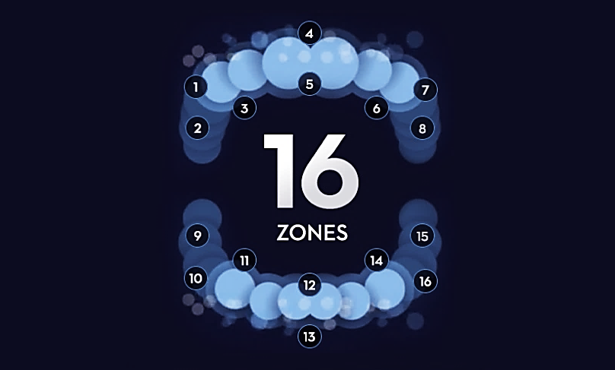
Motivation
Significance of brushing monitoring
Brushing teeth carefully in proportionate duration can reduce dental plaque, maintain good oral hygiene, and prevent oral diseases.
However, ordinary people spend disproportionate time on different tooth surfaces, which can negatively impact oral health.
Therefore, it is necessary to monitor the toothbrushing situation and show this to the users for brushing improvement.
Notes:
As we all know, brushing teeth carefully can reduce dental plaque and prevent oral diseases. However, ordinary people spend disproportionate time on different tooth surfaces. For example, people spend more time brushing the occlusal surface and less time on the inner surface. These can lead to negative impact on oral health. So, it is necessary to monitor the brushing situation and provide feedback to the users.

Slide 3
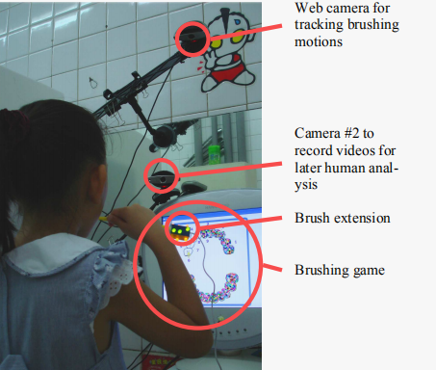
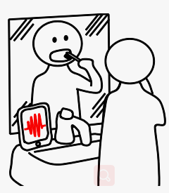
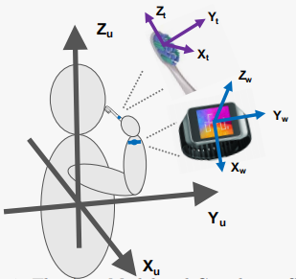
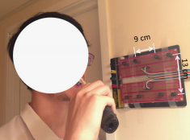



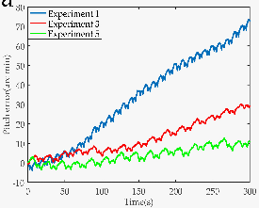

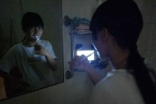

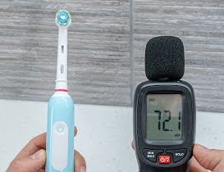


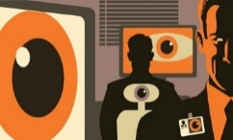
Motivation
Limitations of existing work
Is there a new low-cost and easy-to-deploy sensing paradigm that enables robust and high-accuracy toothbrushing monitoring across various environments and user motion conditions?
Existing methods are limited by high costs, impractical deployment, low accuracy, and poor robustness.
Camera-based
[CHI 08]
Microphone-based
[UbiComp 15, GlobeCom 17, MobiCom 20]
IMU-based
[SenSys 15, INFOCOM 19, UbiComp 21]
Magnetic sensor-based
[SenSys 16, MobiCom 20]
Web camera
Phone recording audio
High costs
Right
Left
Cannot distinguish between left and right teeth
IMU accumulated error increases over time
Inconvenient deployment
Failure in low-light conditions
Failure with electromagnetic interference
Failure with electric toothbrush
Failure with user motion
Raising privacy concerns
Failure with user motion
Notes:
There are various existing methods for toothbrushing monitoring, including using camera, microphone, imu, and magnetic sensor. However, these methods suffer from limitations, like high costs, impractical deployment, low accuracy, and poor robustness. For instance, camera-based methods are expensive and fail in low-light conditions. Microphone-based methods cannot distinguish between left and right teeth. IMU-based methods face accuracy decline from accumulated drift errors and user motion. Magnetic sensor-based methods are inconvenient to deploy and fail with user motion.
So, we ask this question: Is there a new low-cost and easy-to-deploy sensing paradigm that enables robust and high-accuracy toothbrushing monitoring across various environments and user motion conditions.

Slide 4

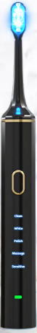
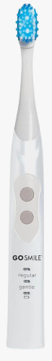
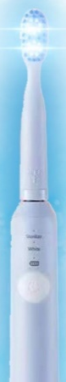
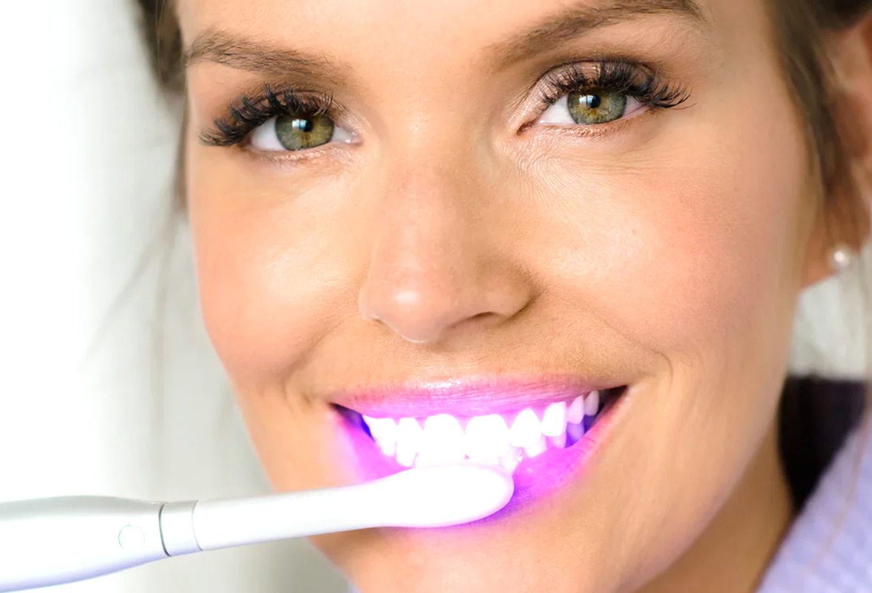



Opportunity
Blue light LED toothbrush
More and more commercial toothbrushes deploy blue light LED.
Blue light can kill oral bacteria and whiten teeth.
Notes:
Fortunately, we have found this opportunity. We found that more and more commercial toothbrushes deploy blue light LED, which can kill oral bacteria and whiten teeth.

Slide 5
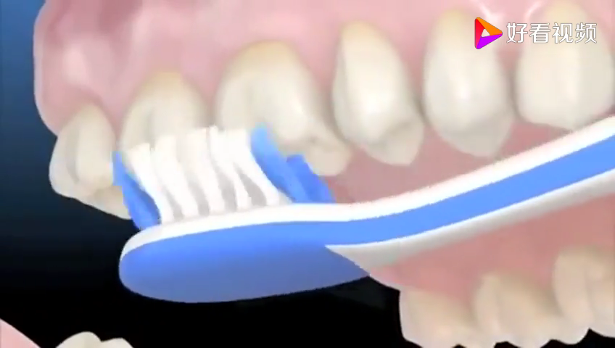
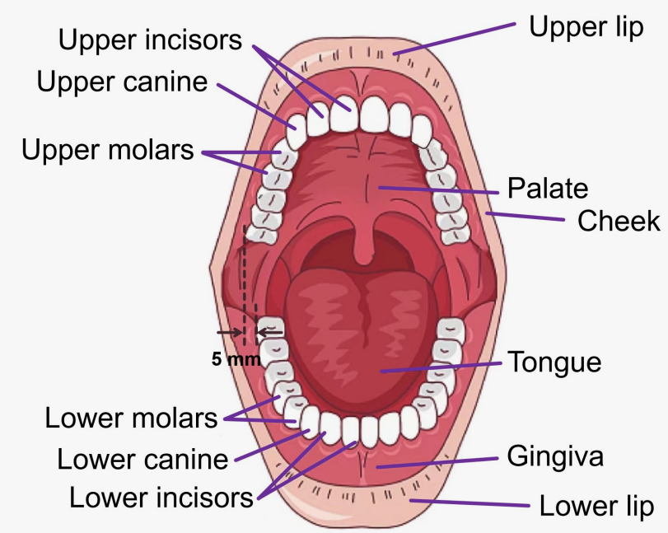
Opportunity
Oral structure and brushing motion differ for different tooth surfaces
Spatial characteristics of each tooth surface are distinct.
Different tooth surfaces have different brushing motions.
Brushing outer surfaces
Brushing occlusal surfaces
Brushing inner surfaces of molars
Brushing inner surfaces of front teeth
Notes:
Also, different tooth surfaces have distinct spatial characteristics. Moreover, when using the Bass technique, two brushing motions (up-and-down and back-and-forth) are used for different tooth surfaces.

Slide 6
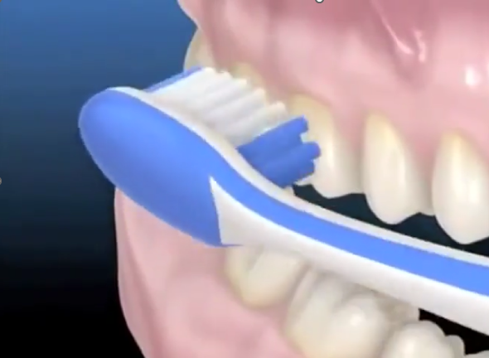
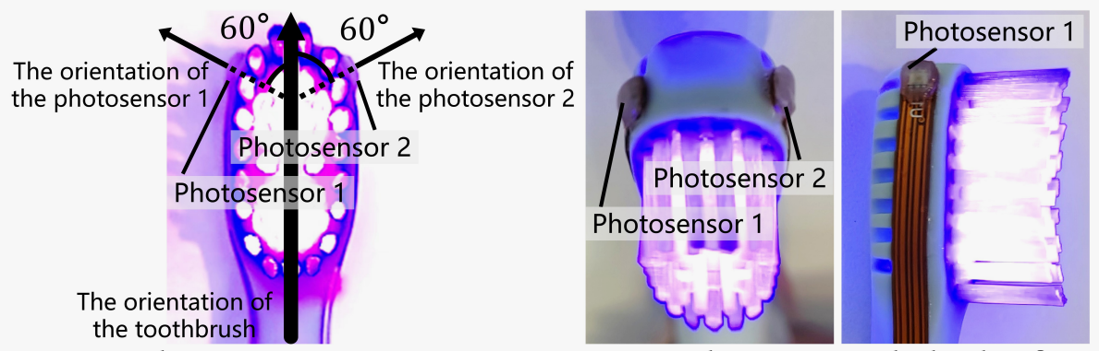
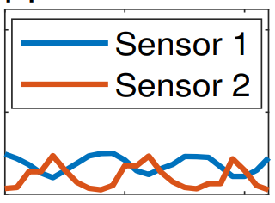
Basic Idea of LiT
Adding two photosensors to the LED toothbrush head
Oral tissue, such as gums
Deploying two low-cost photosensors ($0.581) to the toothbrush head.
Reflected signal
Light signal emitted by toothbrush bristles
Photosensor
NOTE
LiT is robust because the 2 sensors are located inside the mouth while brushing, shielded from environmental disturbances (e.g., light, sound, and electromagnetic fields), and the sensors remain relatively stable in the mouth regardless of the user’s body motions (e.g., moving and turning the head).
Notes:
So, we deploy two low-cost photosensors to the toothbrush head, and we consider the light emitted by the bristles as the transmission signal, and photosensors as signal receivers.
By analyzing the signal reflected from oral tissue, we can infer which tooth surface is being brushed. It's worth noting that our proposal is robust since the photosensors are stably located inside the mouth during brushing, which shields light interference and user motion. Moreover, no matter how the user’s body moves, the sensors remain relatively stable inside the mouth.

Slide 7
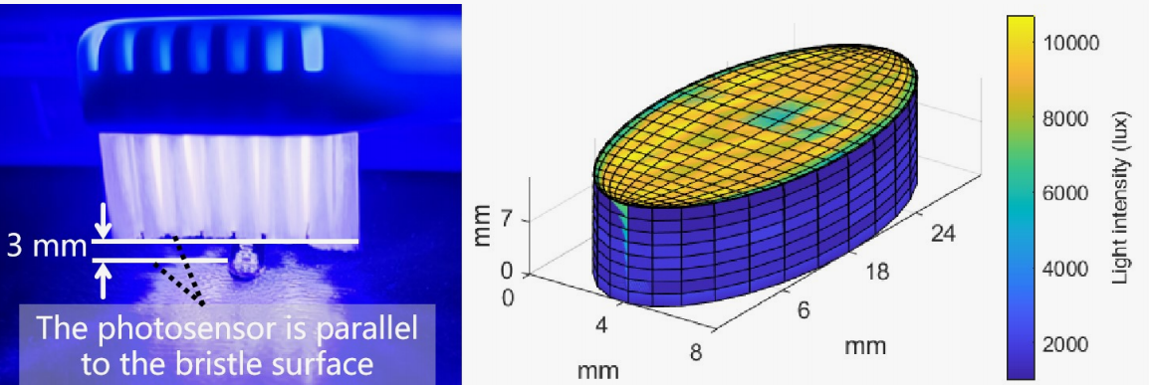
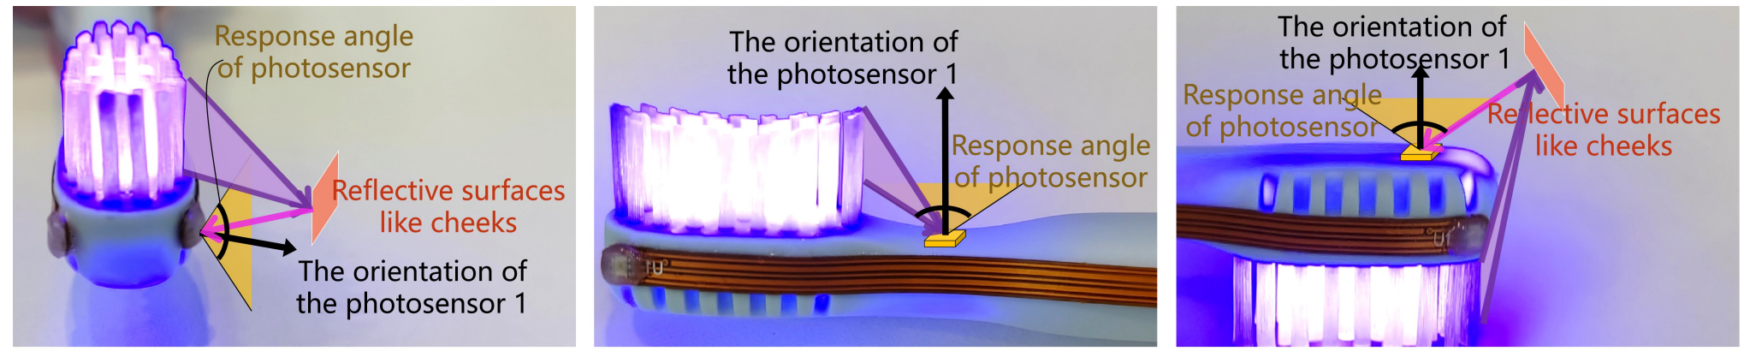
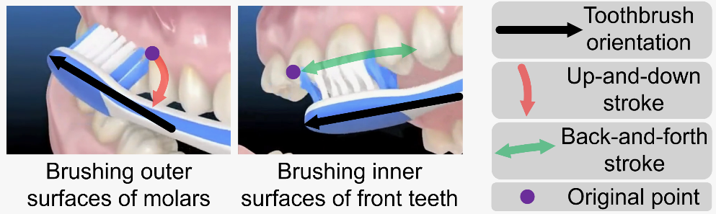
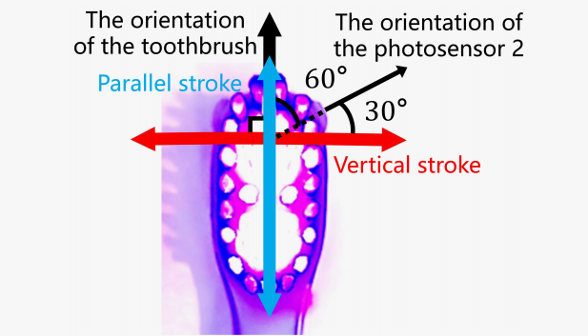
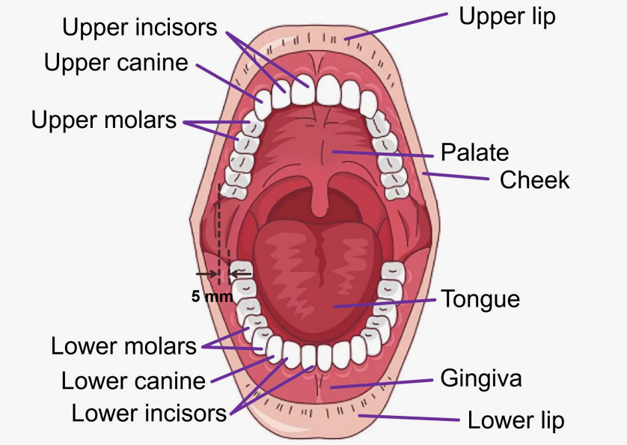
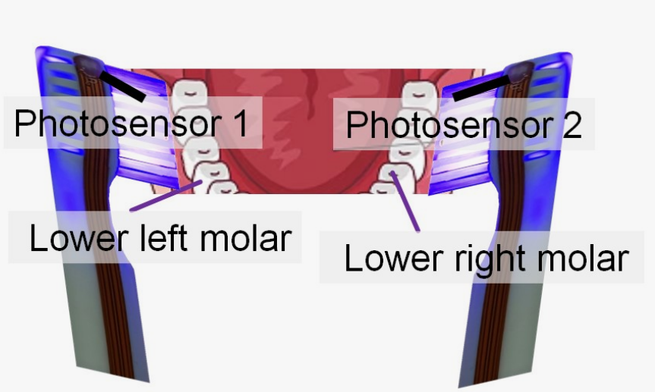
Considerations of Photosensor Deployment Position
Three considerations from luminous properties, brushing motion, and oral structure
Consideration.
Design.
01: Luminous properties
01: Deploying the sensor to the toothbrush head’s side
✔
❌
❌
02: Brushing directions
02: Deploying the sensor at the intersection of two brushing directions
03: Symmetrical oral structure
03: Deploying 2 sensors with different addresses on both sides
Notes:
To translate the concept into an actual system, the first step is to consider the sensor deployment position. Firstly, we found that the toothbrush light source can be simplified as a set of point light sources. So, we deploy the sensor to the side of the toothbrush head, which can block direct light and ensure a stronger light reflection. Secondly, Since there are two directions of brushing, both vertical and parallel to the toothbrush, we deploy the sensor in a direction that intersects both to receive light changes from both directions. Thirdly, since the left and right oral structures are symmetrical, we deploy two sensors with different addresses on both sides of the toothbrush to distinguish between the left and right.

Slide 8
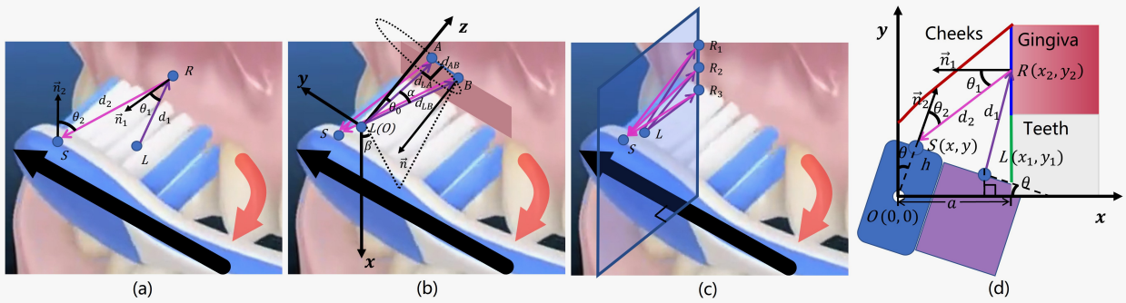
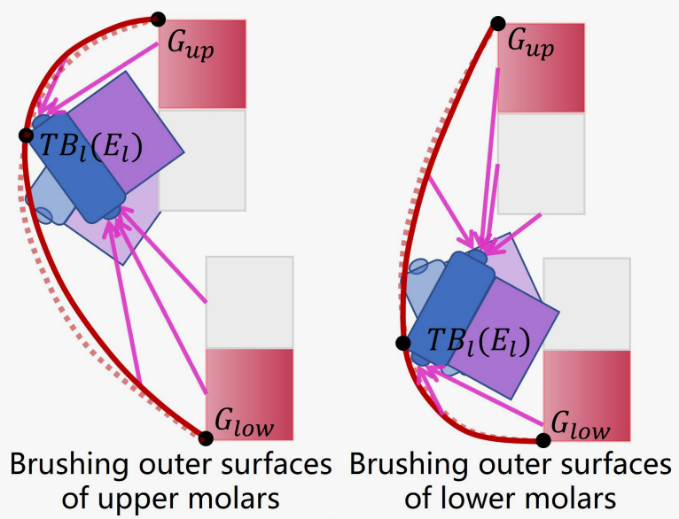
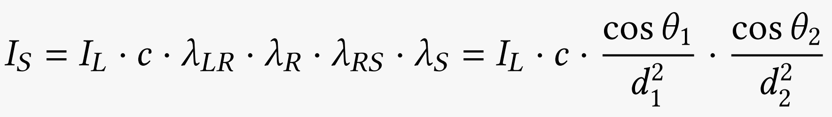
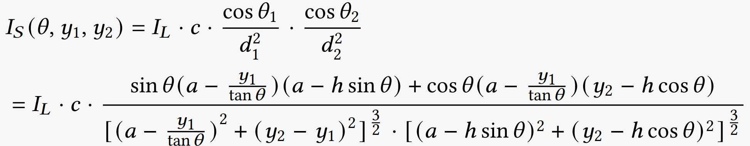
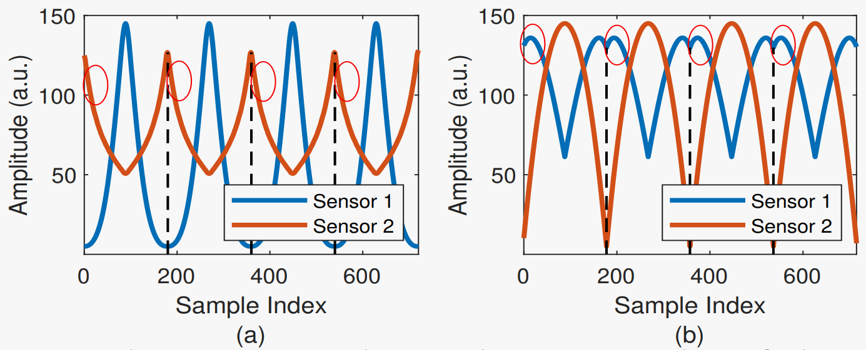

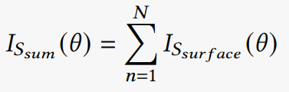
Channel Model & Numerical Simulation
Working principle and theoretical feasibility
Light channel model and dynamic light intensity function.
The numerical simulation signals are different for different tooth surfaces.
Notes:
We have established a channel model of blue light in the mouth to derive the working principle. We can see that the numerical simulation signal is different for different tooth surfaces. You can refer to our paper for more details about this part.

Slide 9
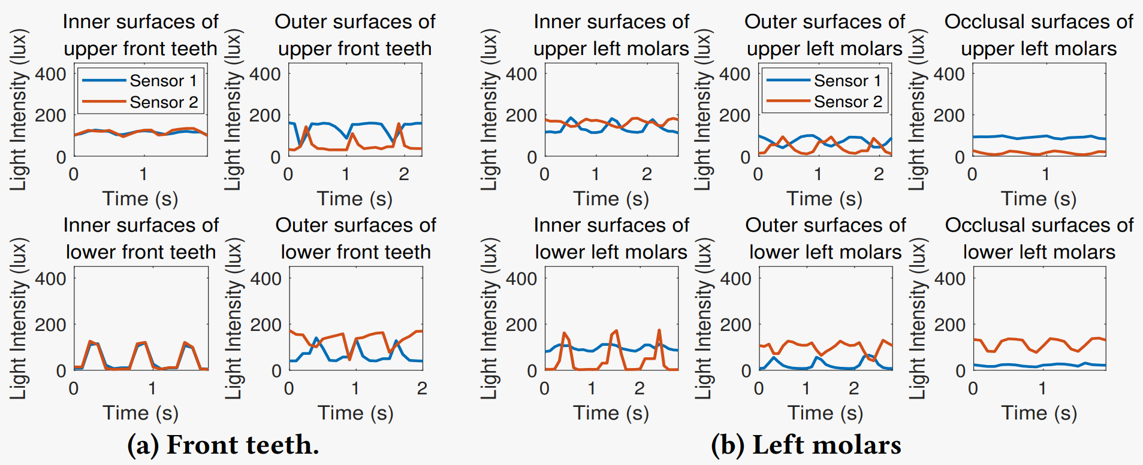
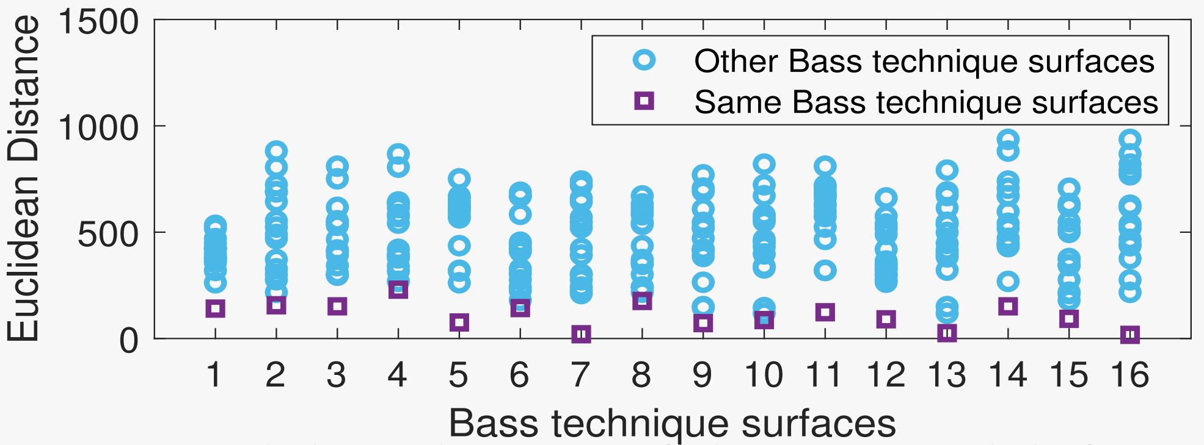
Signal of 16 Bass Technique Surfaces
Intergroup Euclidean distance is greater than Intragroup Euclidean distance
The waveforms of collected brushing signals on different tooth surfaces are different.
Intergroup Euclidean distance is greater than Intragroup Euclidean distance.
Notes:
In addition to numerical simulations, the brushing signals collected from actual users also show different waveforms on different tooth surfaces.
We also calculated the intergroup and intragroup Euclidean distance of the signal, and we found that the Intergroup distance is greater than the Intragroup distance, which also verifies the feasibility and effectiveness of the hardware design.

Slide 10
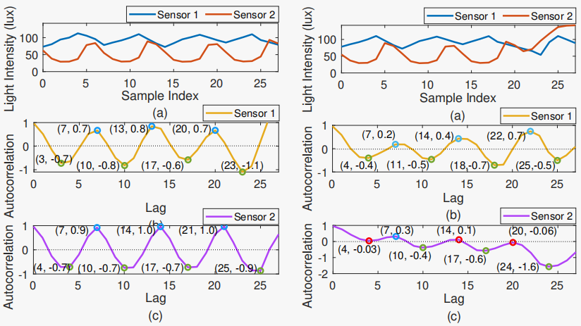
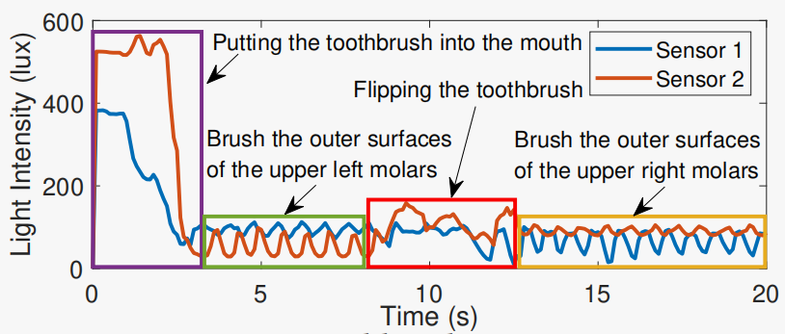
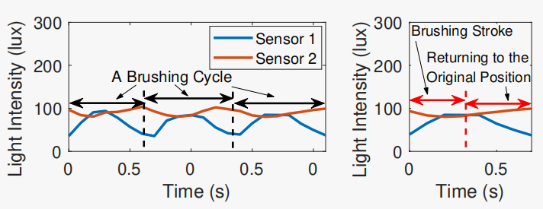
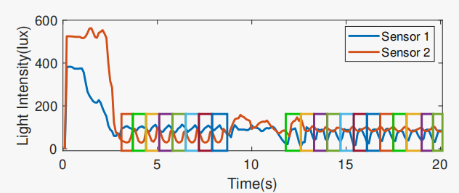
Challenge & Solution 1
Brushing Signal Segmentation
SOLUTION.
Calculating the autocorrelation of 2 sensor signals. If both peaks>0.15 and valleys
<-0.15, it is considered as a brushing signal.
OBSERVATION.
The toothbrush signal exhibits periodicity and symmetry.
Notes:
However, To achieve automatic recognition, we must overcome some challenges. The first challenge is the segmentation of the brushing signal. We found that even without brushing action, the sensors still receive strong light signals. Fortunately, we discovered that brushing is a periodic action, which is also reflected in the signal. Also, due to the toothbrush returning to its original position after each stroke, the signal is symmetrical. So, we use the signal's autocorrelation to distinguish the brushing signals. We consider signals with autocorrelation peaks greater than 0.15 and valleys less than -0.15 as brushing signals. We can see that the segmentation result is good.

Slide 11
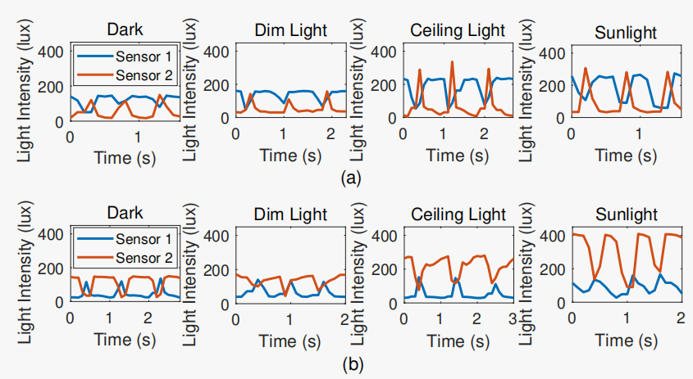
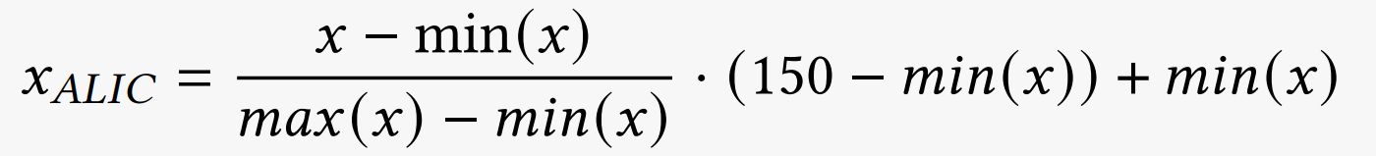
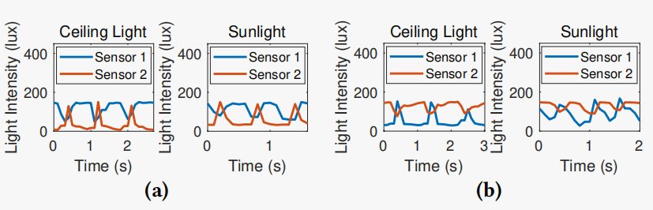
Challenge & Solution 2
Ambient Light Interference Cancellation
OBSERVATION.
Ambient light interferes the brushing signals
on the outer surfaces of the front teeth, all reaching a maximum of more than 250 lux.
SOLUTION.
Using a formula to compress the light intensity to below 150 lux, with no changes to the minimum and waveform of the signal.
Upper front teeth
Lower front teeth
Notes:
The second challenge is that we found that the ambient light actually affects the brushing signal on the outer surfaces of the front teeth. We found that this ambient light effect is reflected in an increase in the maximum value, but there was no significant change in the waveform and minimum value. So, we propose a formula to compress the light intensity to below 150 lux, with no changes to the minimum and waveform.

Slide 12
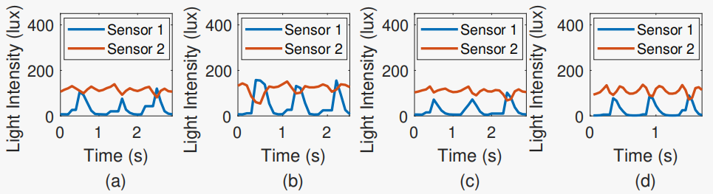
Challenge & Solution 3
User Variability
OBSERVATION.
User variability is mainly reflected in slight differences in the duration and amplitude of the signal.
SOLUTION.
Extracting relationship features between 2 sensor signals.
Root mean square difference
Mean Euclidean distance
Cosine distance
Pearson correlation coefficient
NOTE
Note that our extracted features are not affected by signal length, and are immune to duration differences in user variability.
Notes:
Thirdly, different users’ brushing signals show variability in the duration and amplitude. We extract relationship features between 2 sensor signals to counter this instability and amplify the differentiation of the brushing surfaces. For example, we calculate the mean Euclidean distance to reflect the similarity of the oral structure on both two sides of the toothbrush. It’s worth noting that the features we extracted are not affected by signal length.

Slide 13
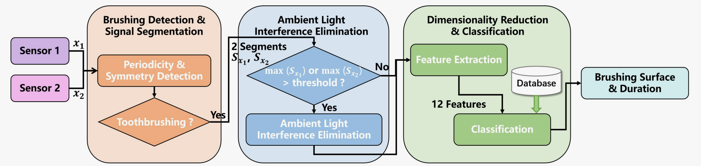
Framework
Ensuring Simplicity, Accuracy and Robustness
Notes:
To summarize the technical proposal, this is the system framework. LiT first segments the brushing signals, then eliminates the ambient light influence on the outer surfaces of the front teeth, and finally extracts features and feeds them to the classifier.

Slide 14
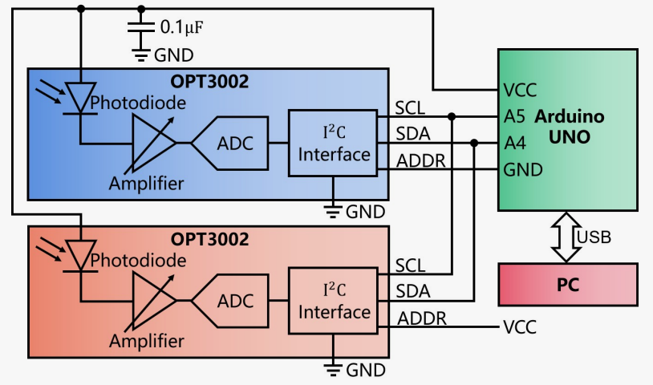
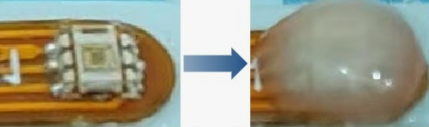
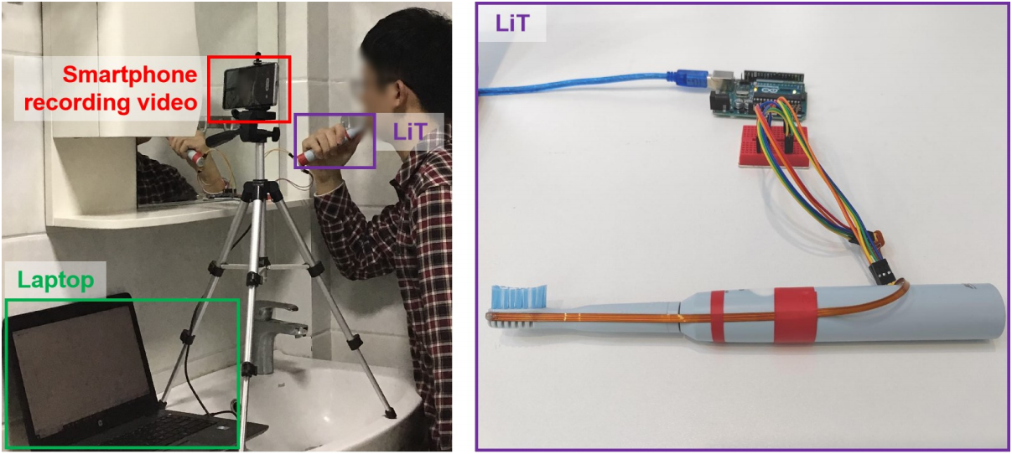
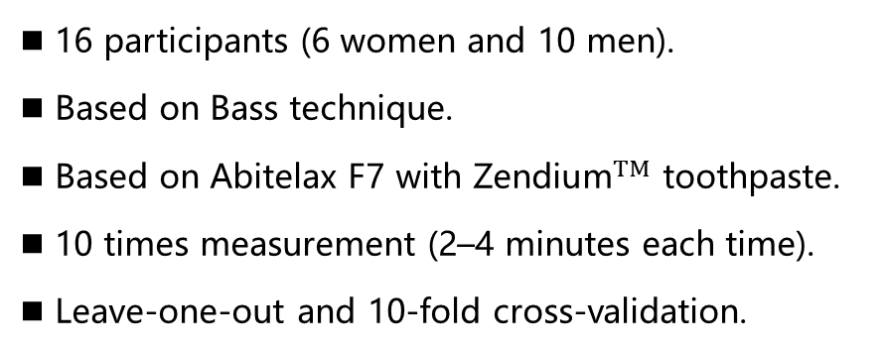
Evaluation
Experimental setup and hardware implementation
Experimental Setup.
  ■ 16 participants (6 women and 10 men).
  ■ Based on Bass technique.
  ■ Based on Abitelax F7 with ${\text{Zendium}}^{TM}$ toothpaste.
  ■ 10 times measurement (2–4 minutes each time).
  ■ Leave-one-out and 10-fold cross-validation.
Hardware Implementation.
  ■ Photosensor was Texas Instruments OPT3002 ($0.581).
  ■ ADDR pins of the 2 photosensors were connected to the GND and VCC pins of the Arduino.
  ■ The photosensor was covered with a layer of about 0.6mm transparent food-grade silicone rubber.
  ■ Flexible PCBs were 223.1 mm×3.8 mm×0.7 mm.
Notes:
This is our experimental setup and LiT prototype, evaluated by 16 users who used the Bass technique to brush their teeth 10 times. We calculated the recognition accuracy using the leave-one-out and ten-fold cross-validation. It is worth mentioning that the sensor was covered with a layer of about 0.6mm transparent silicone rubber to waterproof.

Slide 15
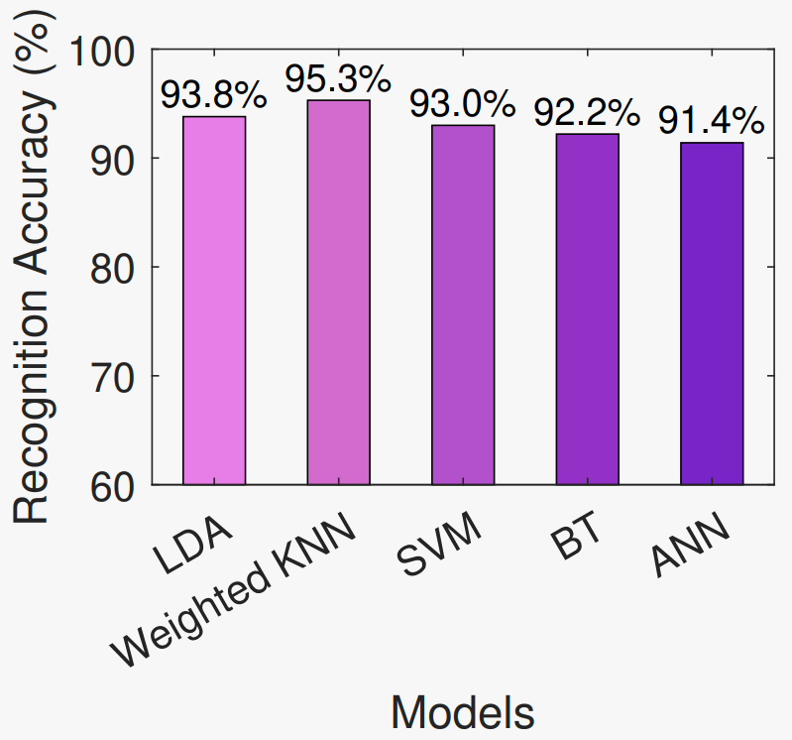
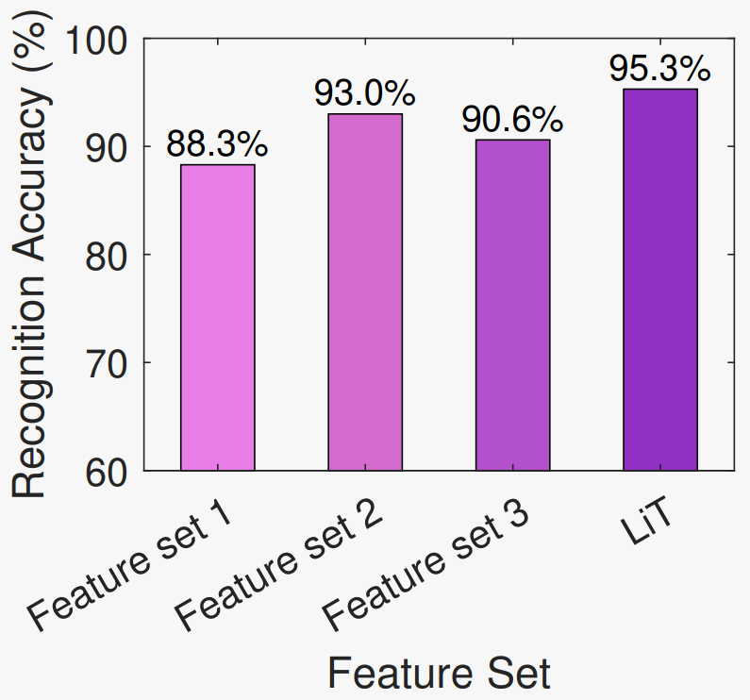
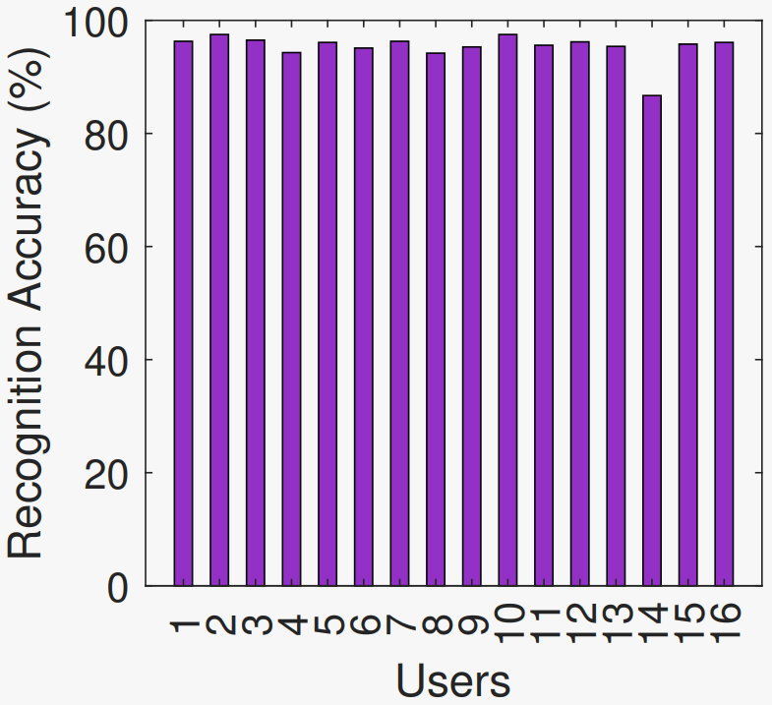
Evaluation
Toothbrushing Monitoring Performance
Impact of the Model.
Impact of User Variability.
Different Feature Sets.
Feature set 1: Independent features of sensor 1 (4 features).
Feature set 2: Independent features of 2 sensor signals (8 features).
Feature set 3: The relationship features between 2 sensor signals (4 features).
LiT: Feature set 2 + Feature set 3
(12 features).
Notes:
Our experimental results show that we can achieve 90 percent accuracy by only using simple machine-learning classifiers. This may be because the extracted features are low-dimensional and are effective. We chose the weighted KNN as LiT’s classifier since it has the highest accuracy and it has good robustness to outliers. Secondly, we also found that the model can be generalized across users. Thirdly, we found that the independent features of two sensors are more accurate than one sensor. Moreover, the relationship features between 2 sensor signals can further improve the accuracy.

Slide 16
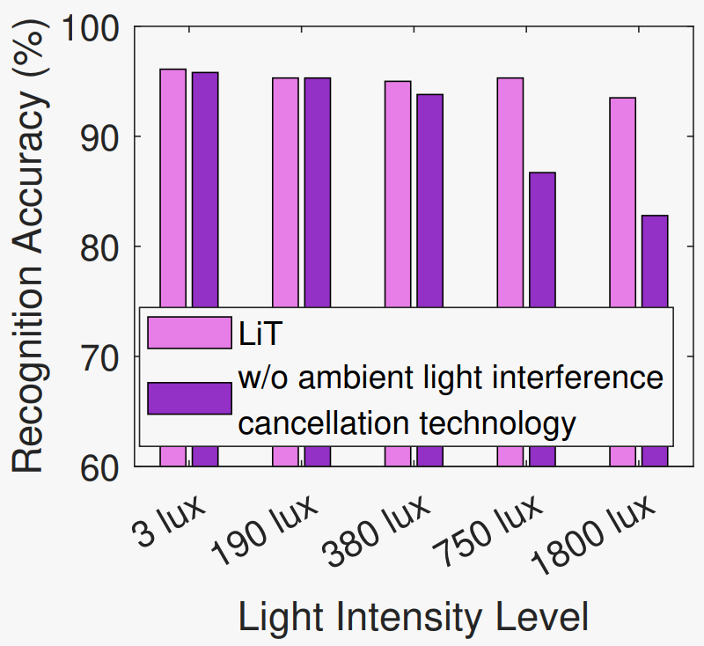


Evaluation
Robustness
Impact of Ambient light.
Impact of User Motion.
Temporal Stability.
(1) Walking up and down in front of the sink when brushing.
(2) Looking down at the video played on the mobile phone beside the sink when brushing.
(3) From standing to sitting on a chair when brushing.
(4) Putting the toothpaste back in its original position on the cabinet over the sink when brushing.
(5) Rinsing non-brushing hands with water from the tap when brushing.
Notes:
In terms of robustness, we also demonstrated that LiT is robust under different ambient light conditions. Also, in different user motion conditions, the accuracy is higher than that of SOTA oral-b io9. In addition, our system is time-stable.

Slide 17






Future Work
Addressing some limitations
Artifact:
https://doi.org/10.5281/zenodo.8260593
Form Design.
Improving user experience and being convenient for placing toothbrush head.
Interactive Paradigm.
Interaction design using the mobile device's touchscreen, speaker, or vibration features.
Studies on Larger Populations.
Covering the entire range of human diversity to promote the deployment.
Artifact operation demo:
https://youtu.be/ZDvkZsqzj4I?si=qA0zRhjSxLRO1TgR
Enhancing Generality.
Expanding to incorrect brushing identification and other brushing methods.
Notes:
However, as a proof-of-concept prototype, the system needs further iterations, including the form design to improve the user experience, interaction design, studies on larger populations, as well as the expansion of the incorrect brushing identification and other brushing methods. By the way, our system is open source. Welcome to scan the code to download our artifact and watch the operation demo.

Slide 18
Thanks for listening.
Notes:
Thank you for your listening and attention.

